Slide 1
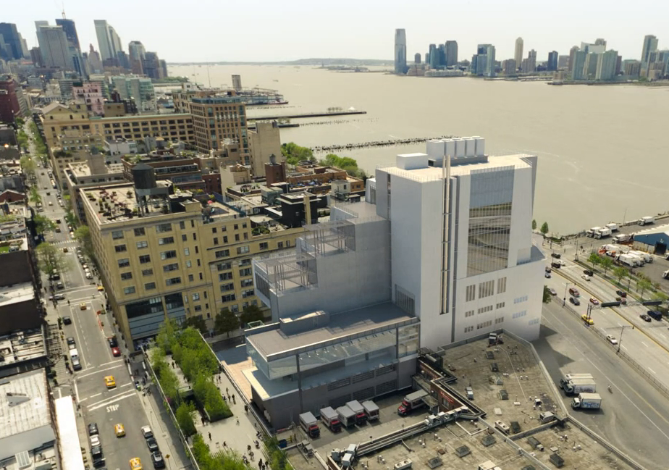
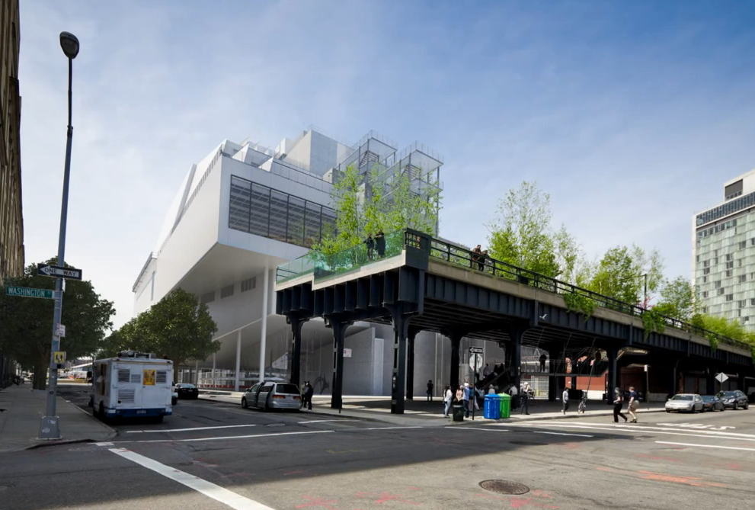
INTRODUCTION | PROJECT OVERVIEW | ANALYSIS 1: GALLERY CEILING PREFABRICATION | ANALYSIS 1A: GALLERY CEILING REDESIGN | ANALYSIS 3: GALLERY FIT-OUT SIPS | CONCLUSIONS AND RECOMMENDATIONS
METRO MUSEUM OF AMERICAN ART
SENIOR THESIS FINAL PRESENTATION
Vincent A. Rossi
Construction Management

Slide 2
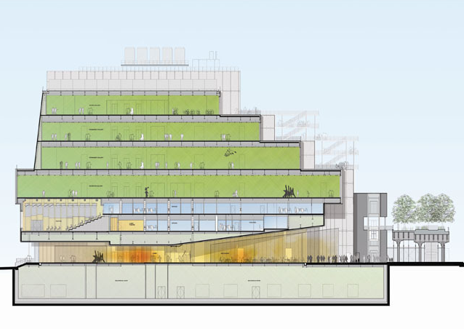
INTRODUCTION | PROJECT OVERVIEW | ANALYSIS 1: GALLERY CEILING PREFABRICATION | ANALYSIS 1A: GALLERY CEILING REDESIGN | ANALYSIS 3: GALLERY FIT-OUT SIPS | CONCLUSIONS AND RECOMMENDATIONS
PROJECT BACKGROUND
General Building Data
  Location:
  Occupancy Type:
  Height :
  Size:
  Total Cost:
  Cost Per Square Foot:
  Dates of Construction:
Major City, United States
Museum / Assembly
9 Stories
222,952 GSF
$266,000,000
$1200
Oct, 2011 – Nov 2014

Slide 3
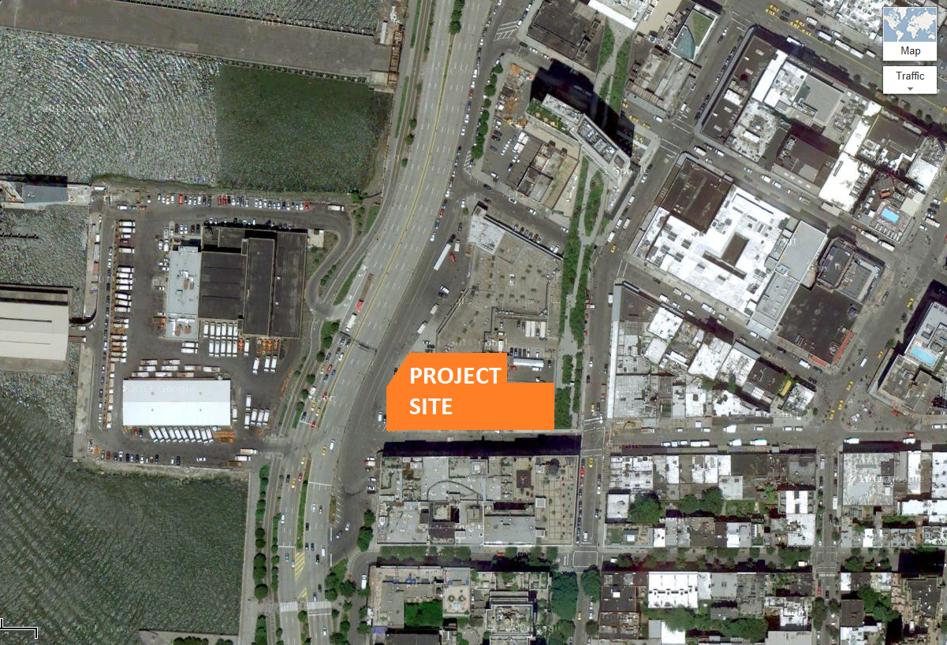
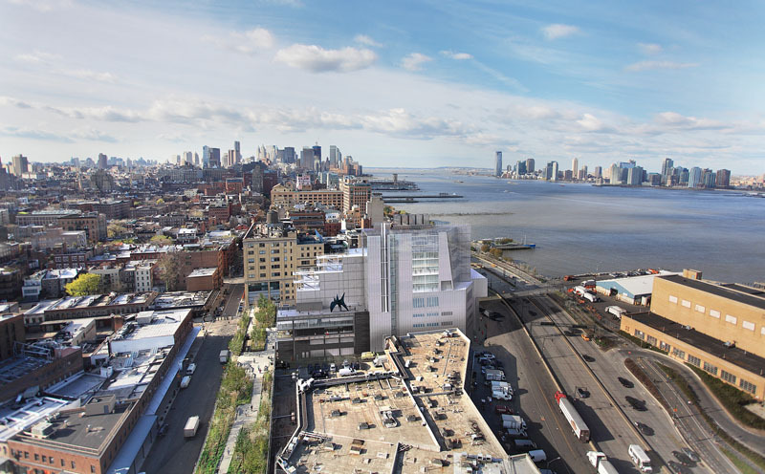
INTRODUCTION | PROJECT OVERVIEW | ANALYSIS 1: GALLERY CEILING PREFABRICATION | ANALYSIS 1A: GALLERY CEILING REDESIGN | ANALYSIS 3: GALLERY FIT-OUT SIPS | CONCLUSIONS AND RECOMMENDATIONS
PROJECT SITE
Project Constraints
  Downtown in a Major U.S. City
  Existing 90’ Tall Building to the South
  Highway access to the West
  Highline Park / Walkway to the East
  Existing Low Rise Buildings to the North
  Highline Maintenance Building Construction
  Constricted Site

Slide 4
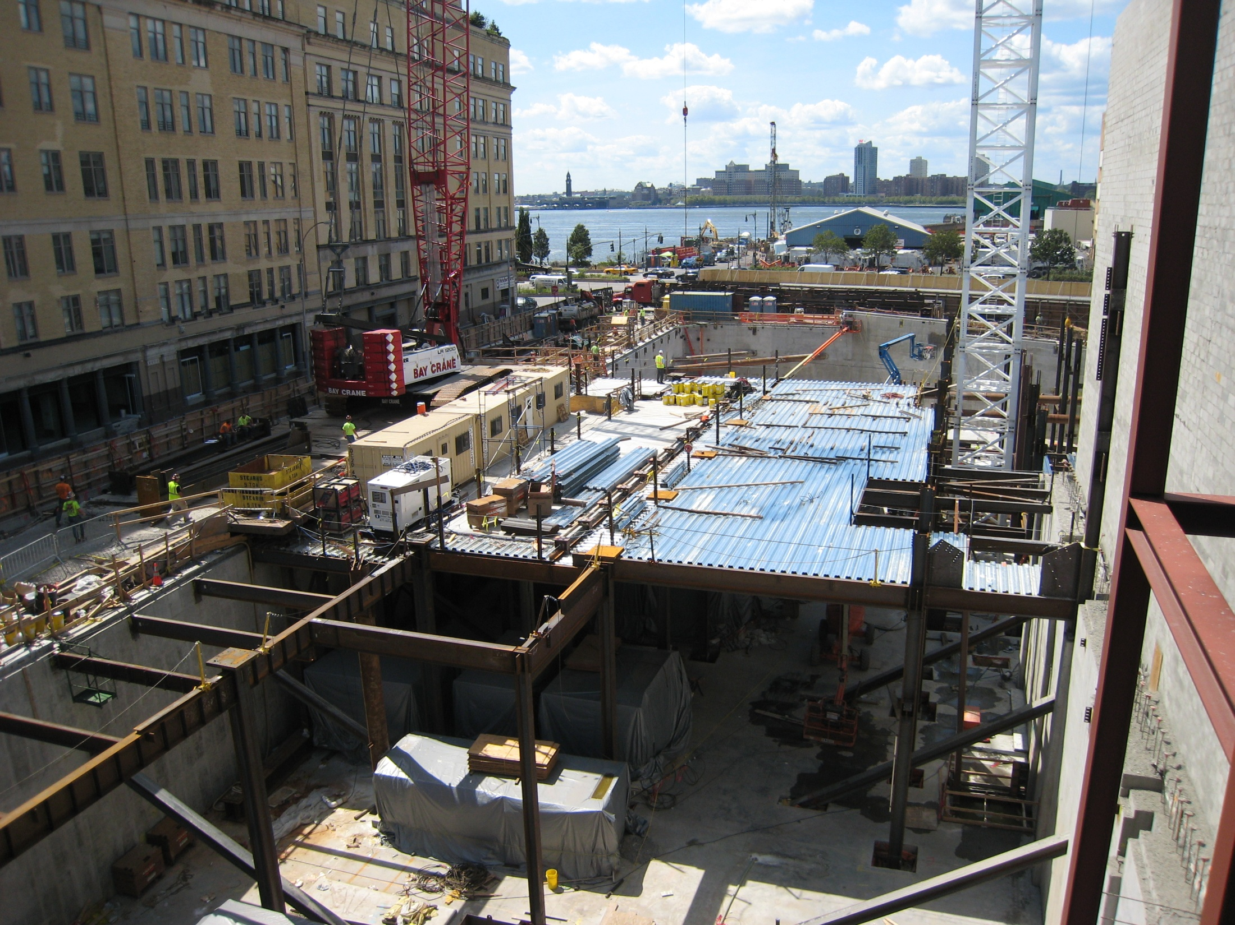
INTRODUCTION | PROJECT OVERVIEW | ANALYSIS 1: GALLERY CEILING PREFABRICATION | ANALYSIS 1A: GALLERY CEILING REDESIGN | ANALYSIS 3: GALLERY FIT-OUT SIPS | CONCLUSIONS AND RECOMMENDATIONS
PROJECT SITE
Project Constraints
  Downtown in a Major U.S. City
  Existing 90’ Tall Building to the South
  Highway access to the West
  Highline Park / Walkway to the East
  Existing Low Rise Buildings to the North
  Highline Maintenance Building Construction
  Constricted Site

Slide 5
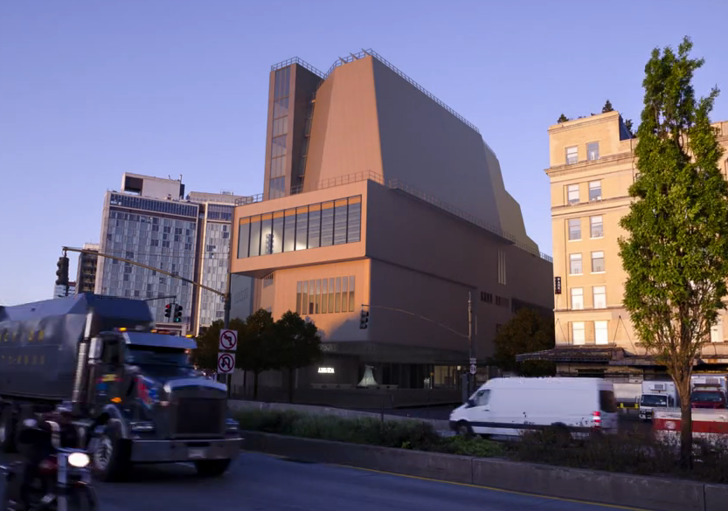
INTRODUCTION | PROJECT OVERVIEW | ANALYSIS 1: GALLERY CEILING PREFABRICATION | ANALYSIS 1A: GALLERY CEILING REDESIGN | ANALYSIS 3: GALLERY FIT-OUT SIPS | CONCLUSIONS AND RECOMMENDATIONS
PROJECT SITE
Project Constraints
  Downtown in a Major U.S. City
  Existing 90’ Tall Building to the South
  Highway access to the West
  Highline Park / Walkway to the East
  Existing Low Rise Buildings to the North
  Highline Maintenance Building Construction
  Constricted Site

Slide 6
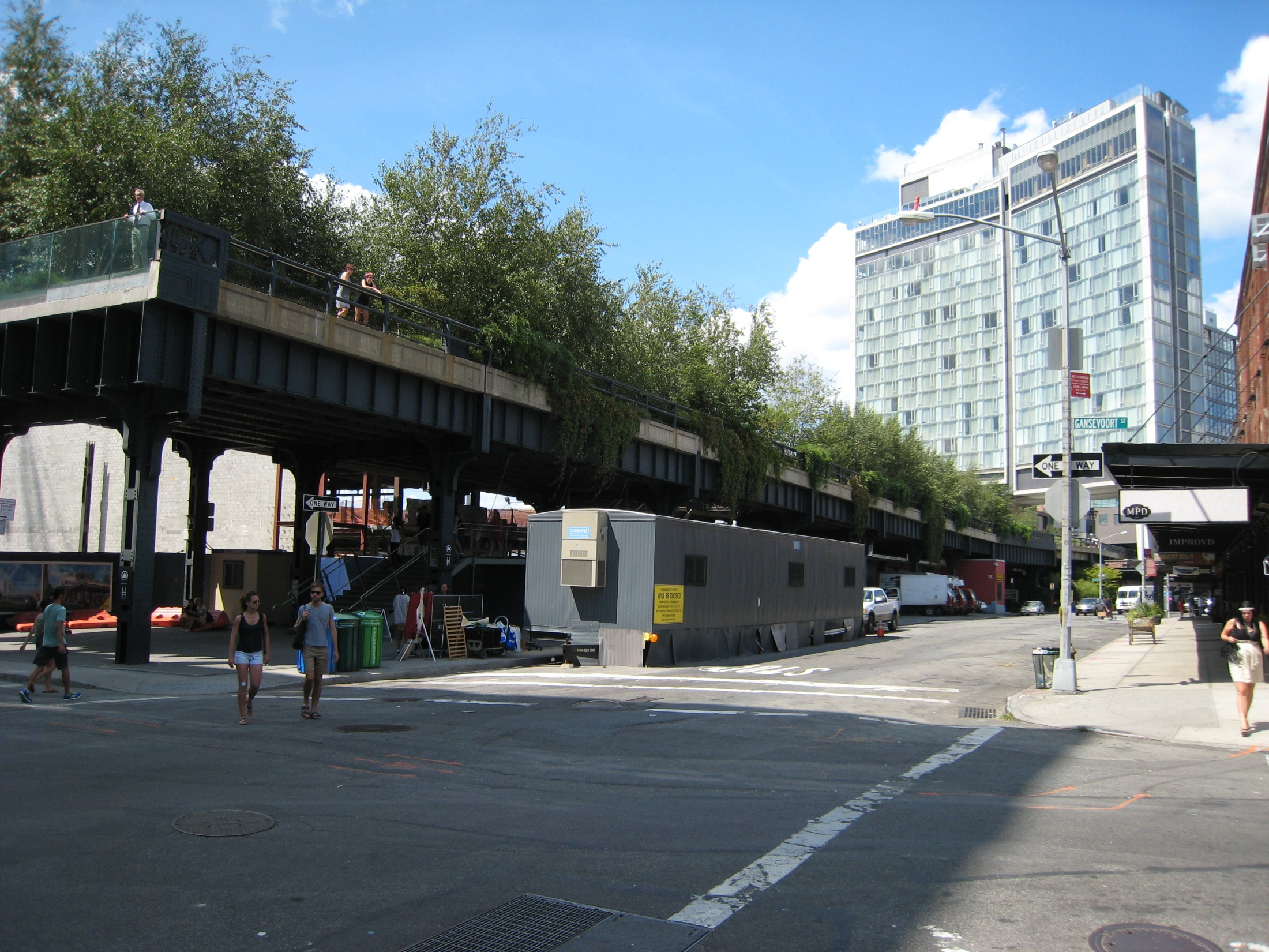
INTRODUCTION | PROJECT OVERVIEW | ANALYSIS 1: GALLERY CEILING PREFABRICATION | ANALYSIS 1A: GALLERY CEILING REDESIGN | ANALYSIS 3: GALLERY FIT-OUT SIPS | CONCLUSIONS AND RECOMMENDATIONS
PROJECT SITE
Project Constraints
  Downtown in a Major U.S. City
  Existing 90’ Tall Building to the South
  Highway access to the West
  Highline Park / Walkway to the East
  Existing Low Rise Buildings to the North
  Highline Maintenance Building Construction
  Constricted Site

Slide 7
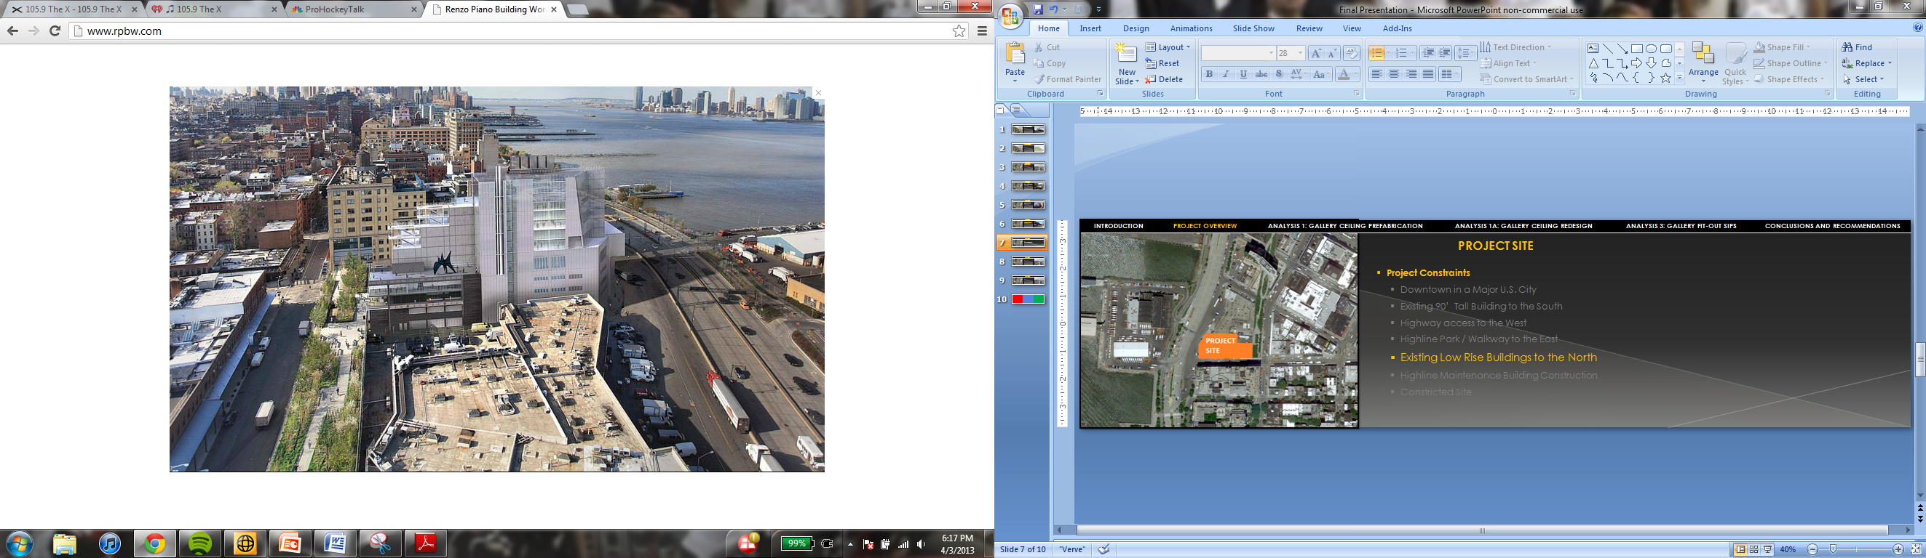
INTRODUCTION | PROJECT OVERVIEW | ANALYSIS 1: GALLERY CEILING PREFABRICATION | ANALYSIS 1A: GALLERY CEILING REDESIGN | ANALYSIS 3: GALLERY FIT-OUT SIPS | CONCLUSIONS AND RECOMMENDATIONS
PROJECT SITE
Project Constraints
  Downtown in a Major U.S. City
  Existing 90’ Tall Building to the South
  Highway access to the West
  Highline Park / Walkway to the East
  Existing Low Rise Buildings to the North
  Highline Maintenance Building Construction
  Constricted Site

Slide 8
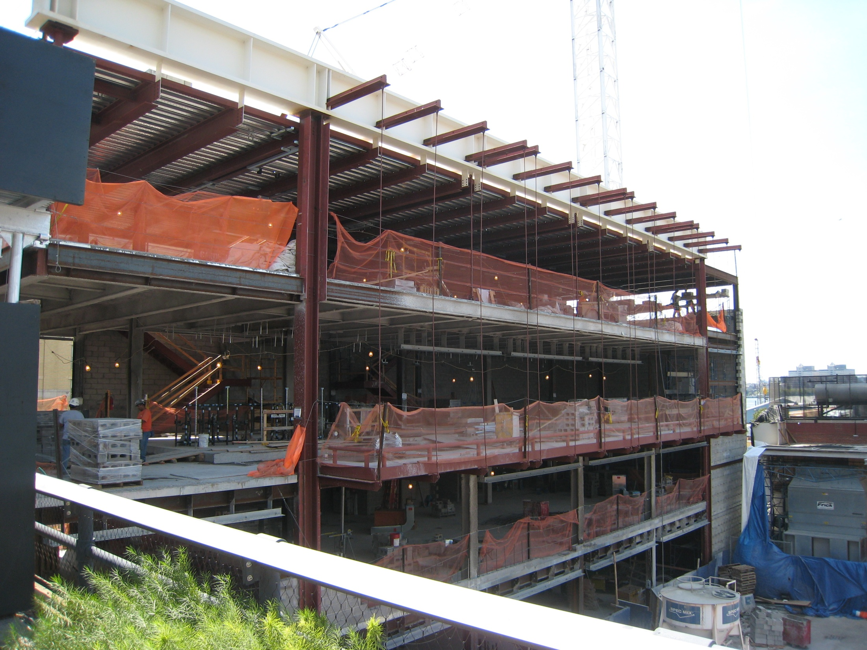
INTRODUCTION | PROJECT OVERVIEW | ANALYSIS 1: GALLERY CEILING PREFABRICATION | ANALYSIS 1A: GALLERY CEILING REDESIGN | ANALYSIS 3: GALLERY FIT-OUT SIPS | CONCLUSIONS AND RECOMMENDATIONS
PROJECT SITE
Project Constraints
  Downtown in a Major U.S. City
  Existing 90’ Tall Building to the South
  Highway access to the West
  Highline Park / Walkway to the East
  Existing Low Rise Buildings to the North
  Highline Maintenance Building Construction
  Constricted Site

Slide 9
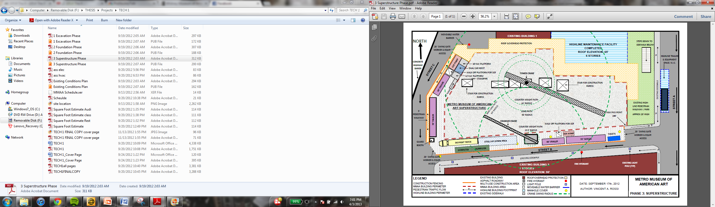
INTRODUCTION | PROJECT OVERVIEW | ANALYSIS 1: GALLERY CEILING PREFABRICATION | ANALYSIS 1A: GALLERY CEILING REDESIGN | ANALYSIS 3: GALLERY FIT-OUT SIPS | CONCLUSIONS AND RECOMMENDATIONS
PROJECT SITE
Project Constraints
  Downtown in a Major U.S. City
  Existing 90’ Tall Building to the South
  Highway access to the West
  Highline Park / Walkway to the East
  Existing Low Rise Buildings to the North
  Highline Maintenance Building Construction
  Constricted Site

Slide 10
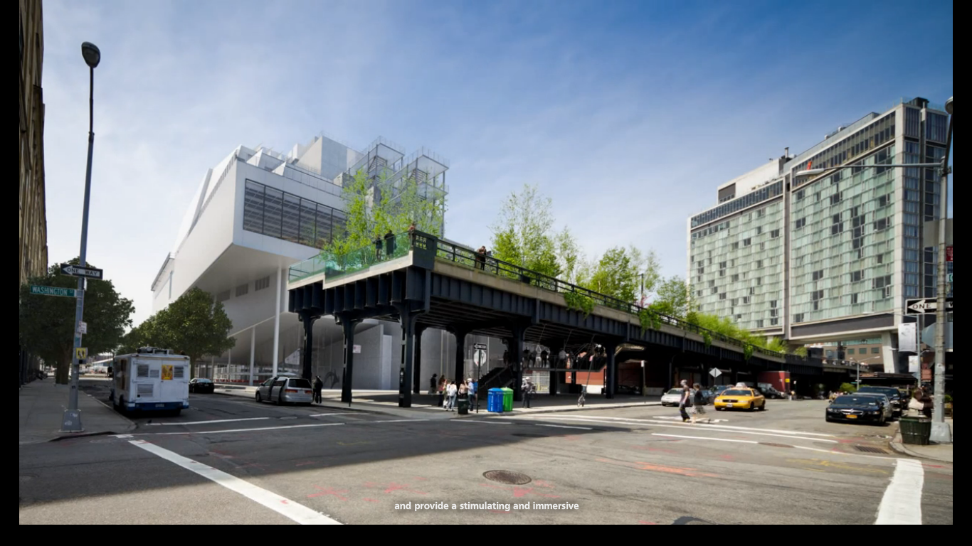

INTRODUCTION | PROJECT OVERVIEW | ANALYSIS 1: GALLERY CEILING PREFABRICATION | ANALYSIS 1A: GALLERY CEILING REDESIGN | ANALYSIS 3: GALLERY FIT-OUT SIPS | CONCLUSIONS AND RECOMMENDATIONS
PROJECT TEAM
Owner: Metro Museum of American Art
Design Architect: Renzo Piano Building Workshop
Architect of Record: Cooper, Robertson & Partners
Construction Manager: Turner Construction Co.

Slide 11
INTRODUCTION | PROJECT OVERVIEW | ANALYSIS 1: GALLERY CEILING PREFABRICATION | ANALYSIS 1A: GALLERY CEILING REDESIGN | ANALYSIS 3: GALLERY FIT-OUT SIPS | CONCLUSIONS AND RECOMMENDATIONS
Owner
Metro Museum of American Art
PROJECT DELIVERY METHOD
Design Architect
Renzo Piano Building Workshop
Architect of Record
Cooper, Robertson, & Partners
Design – Bid – Build Project Delivery Method
Cost Plus Contract with a GMP Option
Construction Manager
Turner Construction Company
Electrical
Allan Briteway
Structural Steel
Banker Steel, Co., LLC
MEP Engineer
Jaros, Baum, & Bolles
Plumbing
Almar Plumbing & Heating Corp.
Concrete
RCC Concrete Corp.
Structural Engineer
Robert Silman Associates
HVAC
PJ Mechanical Corp.
Excavation/ Foundation
Urban Foundation
Civil Engineer
Philip Habib & Associates
Curtain Wall
Permasteelisa NA
All Other Subcontractors
All Other Consultants

Slide 12
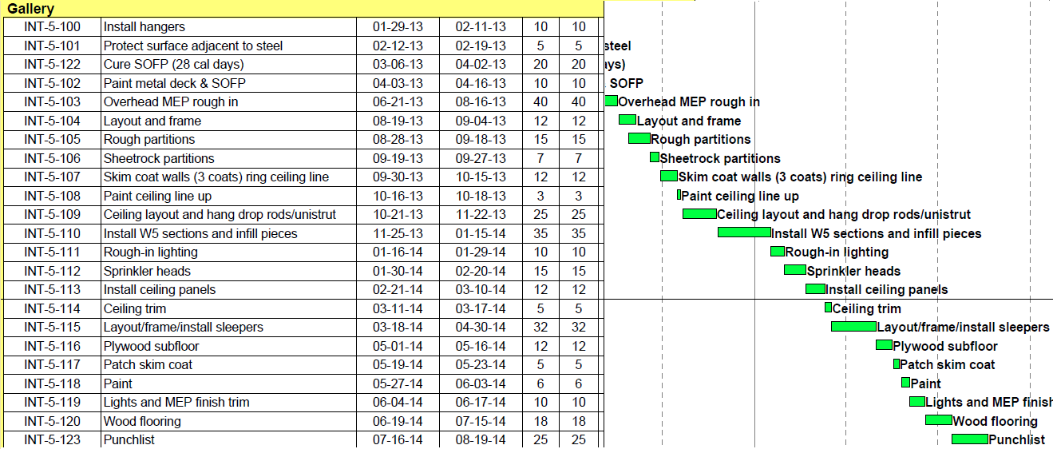
INTRODUCTION | PROJECT OVERVIEW | ANALYSIS 1: GALLERY CEILING PREFABRICATION | ANALYSIS 1A: GALLERY CEILING REDESIGN | ANALYSIS 3: GALLERY FIT-OUT SIPS | CONCLUSIONS AND RECOMMENDATIONS
PROJECT SCHEDULE SUMMARY
37 Month Construction Schedule (10/11 – 11/14)
  Interior fit-out longest project phase by far.
    Due to long gallery fit-outs. (19 Months)
    Start to Finish activity relationships.
    Only one trade active per gallery.
GALLERY FIT-OUT SCHEDULE OVERVIEW
Gallery | Start Date | Finish Date | Duration (Days)
1st Floor Gallery | 19-Dec-12 | 26-Jun-14 | 390
5th Floor Gallery | 29-Jan-13 | 19-Aug-14 | 401
6th Floor Gallery | 12-Feb-13 | 16-Sep-14 | 411
7th Floor Gallery | 21-Feb-13 | 14-Oct-14 | 424
8th Floor Gallery | 28-Feb-13 | 28-Nov-14 | 452
Average |  |  | 416

Slide 13
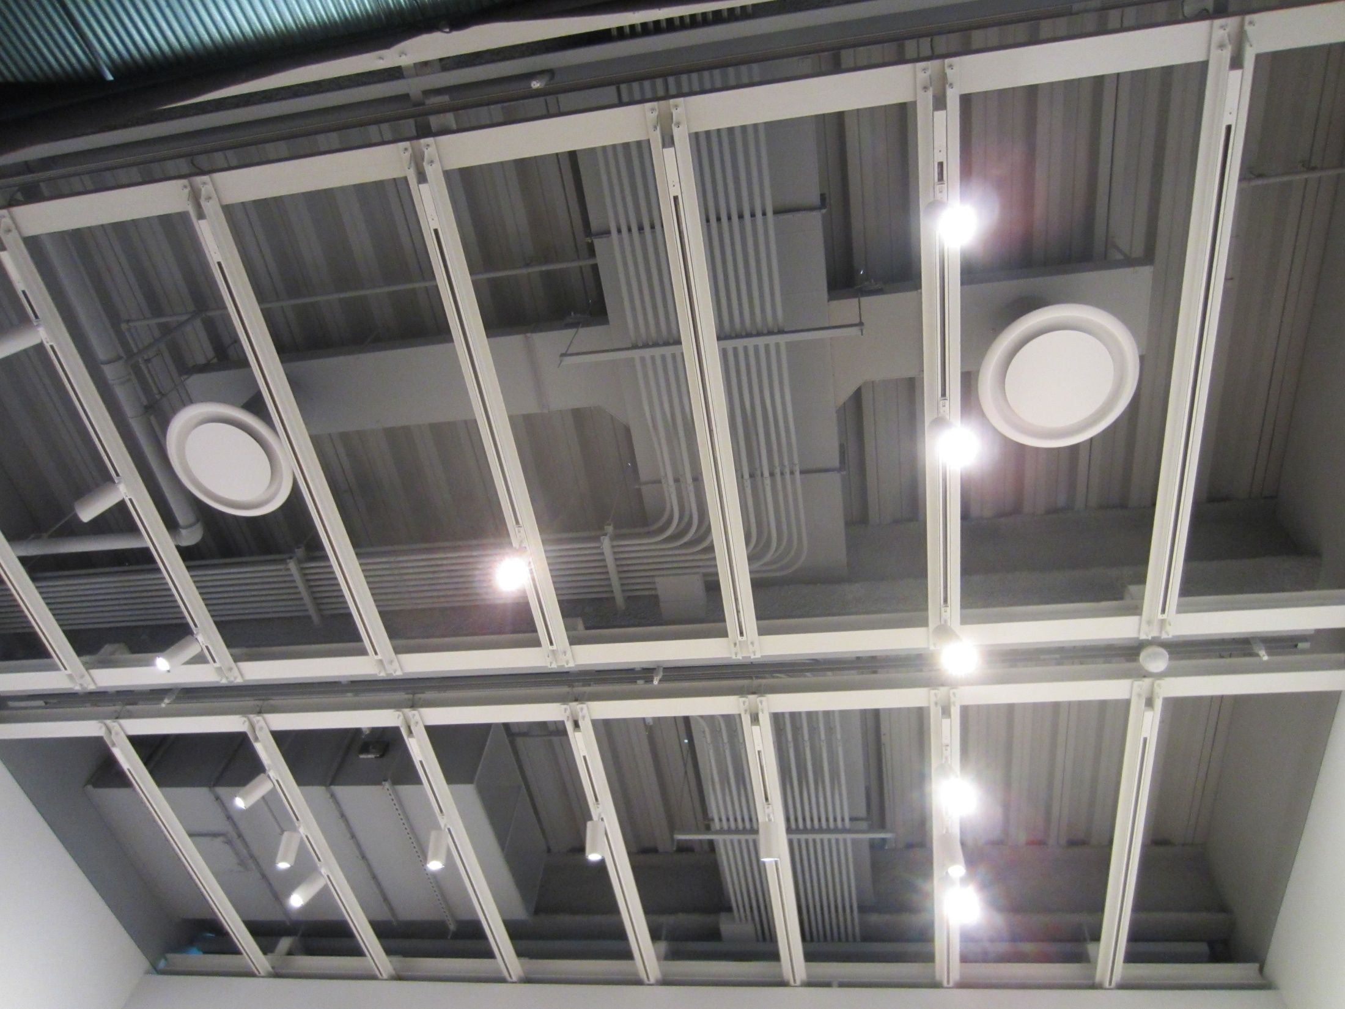
INTRODUCTION | PROJECT OVERVIEW | ANALYSIS 1: GALLERY CEILING PREFABRICATION | ANALYSIS 1A: GALLERY CEILING REDESIGN | ANALYSIS 3: GALLERY FIT-OUT SIPS | CONCLUSIONS AND RECOMMENDATIONS
ANALYSIS 1:
GALLERY CEILING PREFABRICATION

Slide 14
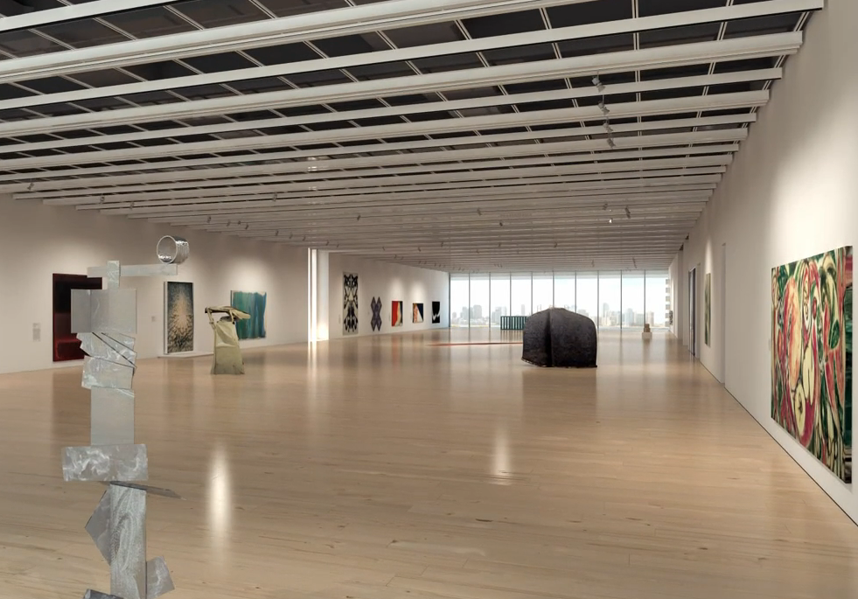
INTRODUCTION | PROJECT OVERVIEW | ANALYSIS 1: GALLERY CEILING PREFABRICATION | ANALYSIS 1A: GALLERY CEILING REDESIGN | ANALYSIS 3: GALLERY FIT-OUT SIPS | CONCLUSIONS AND RECOMMENDATIONS
PROBLEM IDENTIFICATION AND GOALS
Problem:
  Ceiling system takes over 100 days to construct.
Goal:
  Reduce the length of the gallery fit-out schedule.

Slide 15
INTRODUCTION | PROJECT OVERVIEW | ANALYSIS 1: GALLERY CEILING PREFABRICATION | ANALYSIS 1A: GALLERY CEILING REDESIGN | ANALYSIS 3: GALLERY FIT-OUT SIPS | CONCLUSIONS AND RECOMMENDATIONS
PROBLEM IDENTIFICATION AND GOALS
Galleries are located on the 1st, and 5th-8th floors.
Floors 5 – 7 will be prefabricated.
Floors 1 and 8 are substantially different.

Slide 16
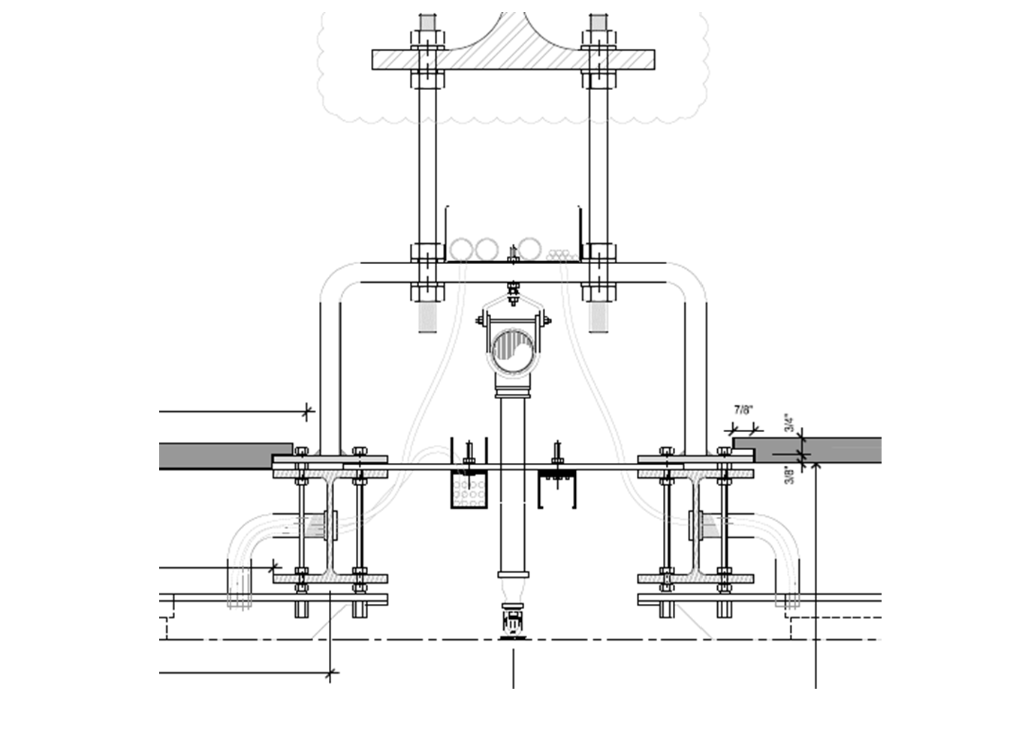
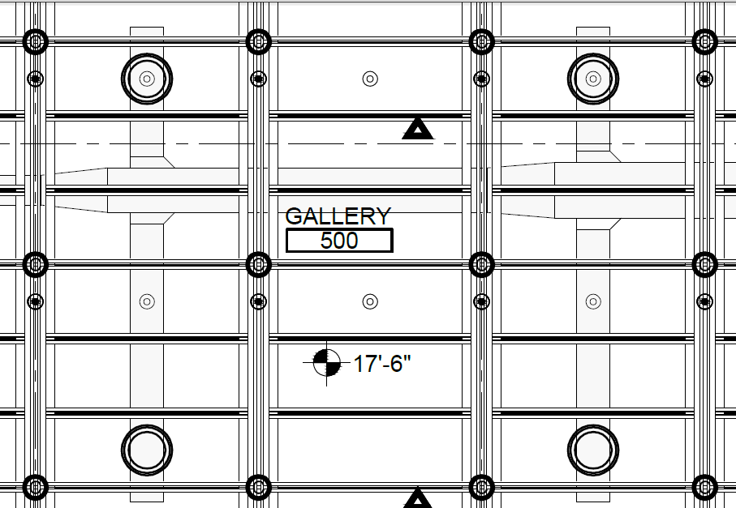
INTRODUCTION | PROJECT OVERVIEW | ANALYSIS 1: GALLERY CEILING PREFABRICATION | ANALYSIS 1A: GALLERY CEILING REDESIGN | ANALYSIS 3: GALLERY FIT-OUT SIPS | CONCLUSIONS AND RECOMMENDATIONS
GALLERY CEILING CONSTRUCTION
Design Elements:
  Grid of structural steel members
    W5x14 Members N-S
    2x2x1/4 Steel Angles E-W
    Bent Steel Plate Hanger
  Lighting Track
  Fire Protection System

Slide 17
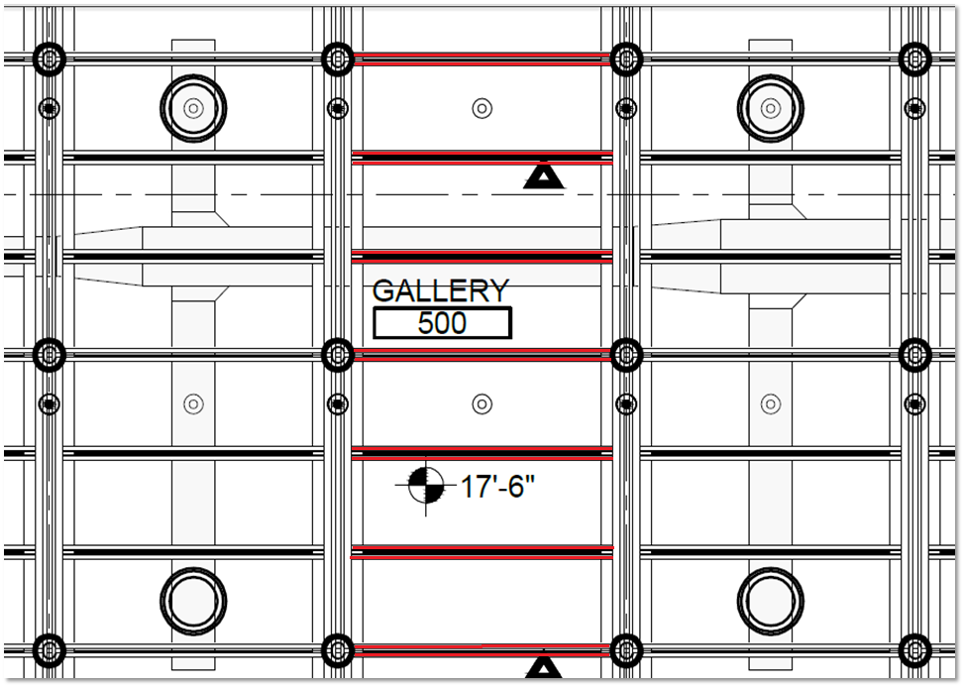
INTRODUCTION | PROJECT OVERVIEW | ANALYSIS 1: GALLERY CEILING PREFABRICATION | ANALYSIS 1A: GALLERY CEILING REDESIGN | ANALYSIS 3: GALLERY FIT-OUT SIPS | CONCLUSIONS AND RECOMMENDATIONS
GALLERY CEILING CONSTRUCTION
Design Elements:
  Grid of structural steel members
    W5x14 Members N-S
    2x2x1/4 Steel Angles E-W
    Bent Steel Plate Hanger
  Lighting Track
  Fire Protection System

Slide 18
INTRODUCTION | PROJECT OVERVIEW | ANALYSIS 1: GALLERY CEILING PREFABRICATION | ANALYSIS 1A: GALLERY CEILING REDESIGN | ANALYSIS 3: GALLERY FIT-OUT SIPS | CONCLUSIONS AND RECOMMENDATIONS
GALLERY CEILING CONSTRUCTION
Design Elements:
  Grid of structural steel members
    W5x14 Members N-S
    2x2x1/4 Steel Angles E-W
    Bent Steel Plate Hanger
  Lighting Track
  Fire Protection System

Slide 19
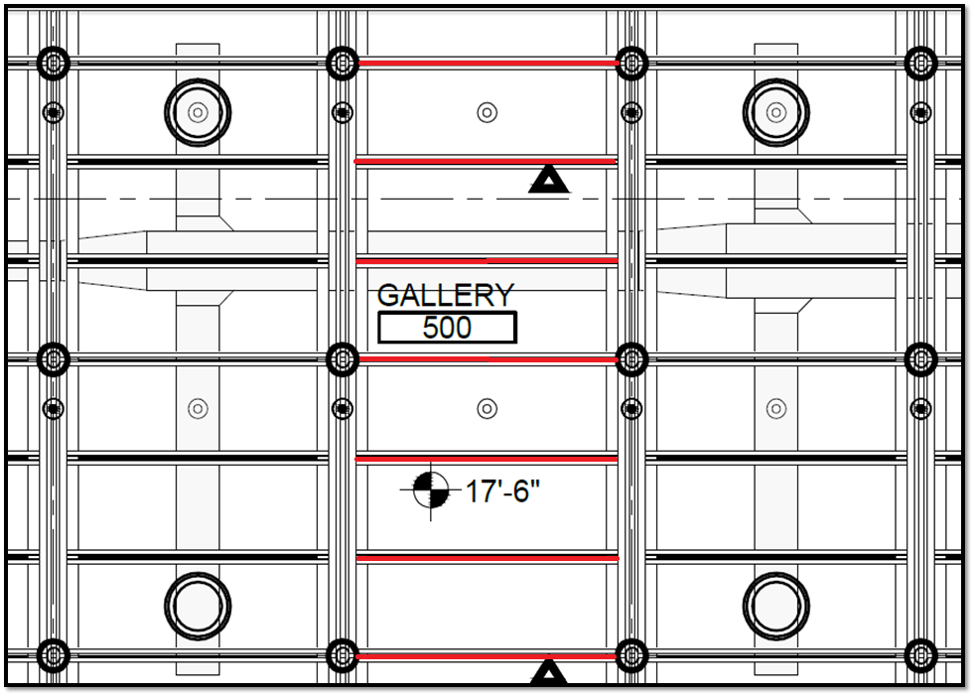
INTRODUCTION | PROJECT OVERVIEW | ANALYSIS 1: GALLERY CEILING PREFABRICATION | ANALYSIS 1A: GALLERY CEILING REDESIGN | ANALYSIS 3: GALLERY FIT-OUT SIPS | CONCLUSIONS AND RECOMMENDATIONS
GALLERY CEILING CONSTRUCTION
Design Elements:
  Grid of structural steel members
    W5x14 Members N-S
    2x2x1/4 Steel Angles E-W
    Bent Steel Plate Hanger
  Lighting Track
  Fire Protection System

Slide 20
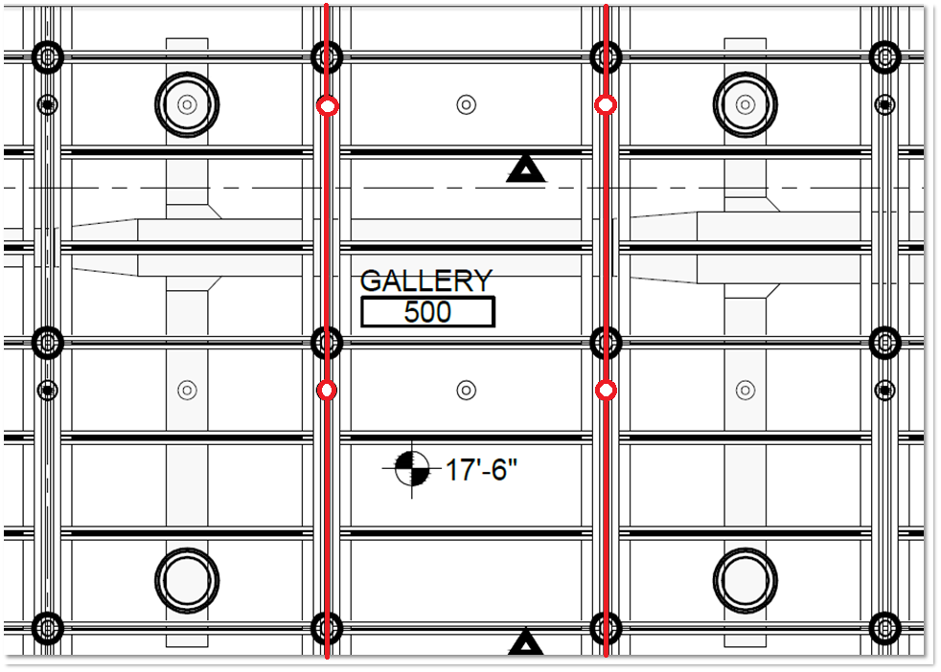
INTRODUCTION | PROJECT OVERVIEW | ANALYSIS 1: GALLERY CEILING PREFABRICATION | ANALYSIS 1A: GALLERY CEILING REDESIGN | ANALYSIS 3: GALLERY FIT-OUT SIPS | CONCLUSIONS AND RECOMMENDATIONS
GALLERY CEILING CONSTRUCTION
Design Elements:
  Grid of structural steel members
    W5x14 Members N-S
    2x2x1/4 Steel Angles E-W
    Bent Steel Plate Hanger
  Lighting Track
  Fire Protection System

Slide 21
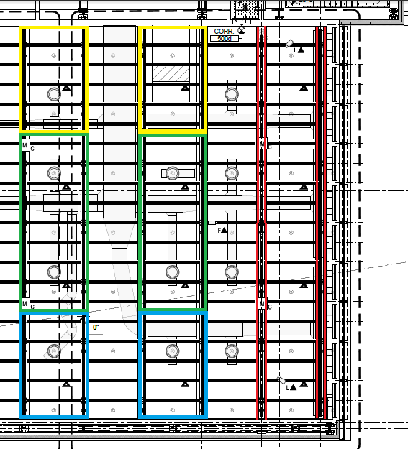
INTRODUCTION | PROJECT OVERVIEW | ANALYSIS 1: GALLERY CEILING PREFABRICATION | ANALYSIS 1A: GALLERY CEILING REDESIGN | ANALYSIS 3: GALLERY FIT-OUT SIPS | CONCLUSIONS AND RECOMMENDATIONS
DESIGN FOR PREFABRICATION
Limiting Size factor: Shipping Width
Module Specifications:
  Group 2 Sets of W5 Members
  Connected with Steel Angle Assembly
  Includes 50% of the Lighting Assemblies
  Includes 100% of the Sprinkler System
  Width: 10’ 10-1/2”
  Varying Lengths

Slide 22
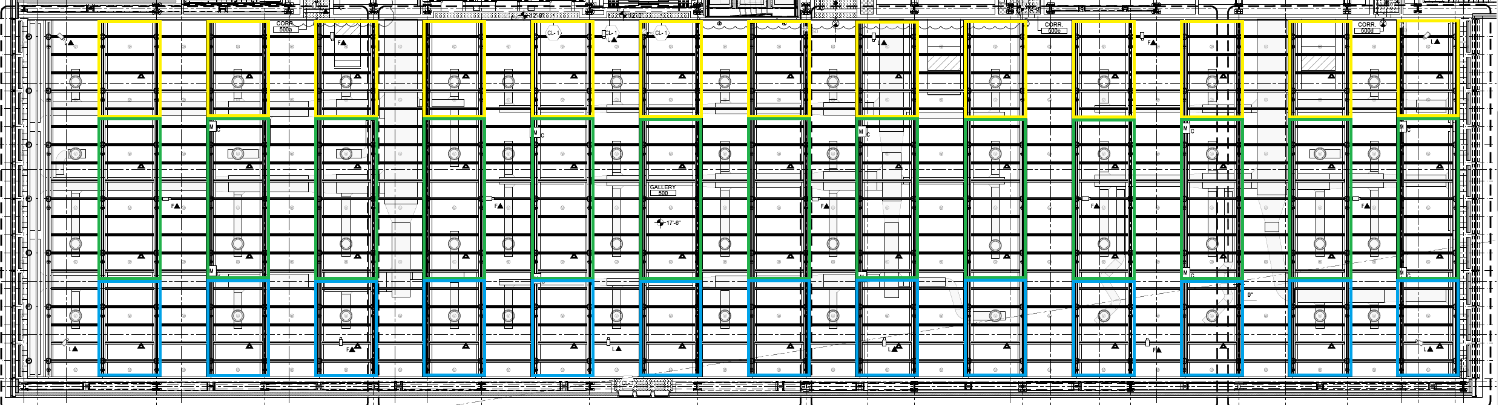
INTRODUCTION | PROJECT OVERVIEW | ANALYSIS 1: GALLERY CEILING PREFABRICATION | ANALYSIS 1A: GALLERY CEILING REDESIGN | ANALYSIS 3: GALLERY FIT-OUT SIPS | CONCLUSIONS AND RECOMMENDATIONS
5th FLOOR GALLERY MODULE LAYOUT
Gallery Dimensions
  260’ x 66’
Module Inventory: 39 Total
  (26), 18’ Modules
  (13), 30’ Modules

Slide 23
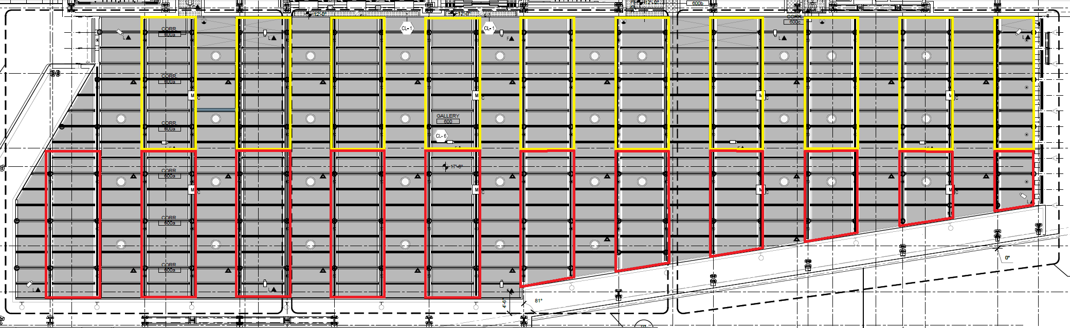
INTRODUCTION | PROJECT OVERVIEW | ANALYSIS 1: GALLERY CEILING PREFABRICATION | ANALYSIS 1A: GALLERY CEILING REDESIGN | ANALYSIS 3: GALLERY FIT-OUT SIPS | CONCLUSIONS AND RECOMMENDATIONS
6th FLOOR GALLERY MODULE LAYOUT
Gallery Dimensions
  216’ x 60’
Module Inventory: 21 Total
  (10), 28’4” Modules
  (6), 31’8” Modules
  (5), Varying Length

Slide 24
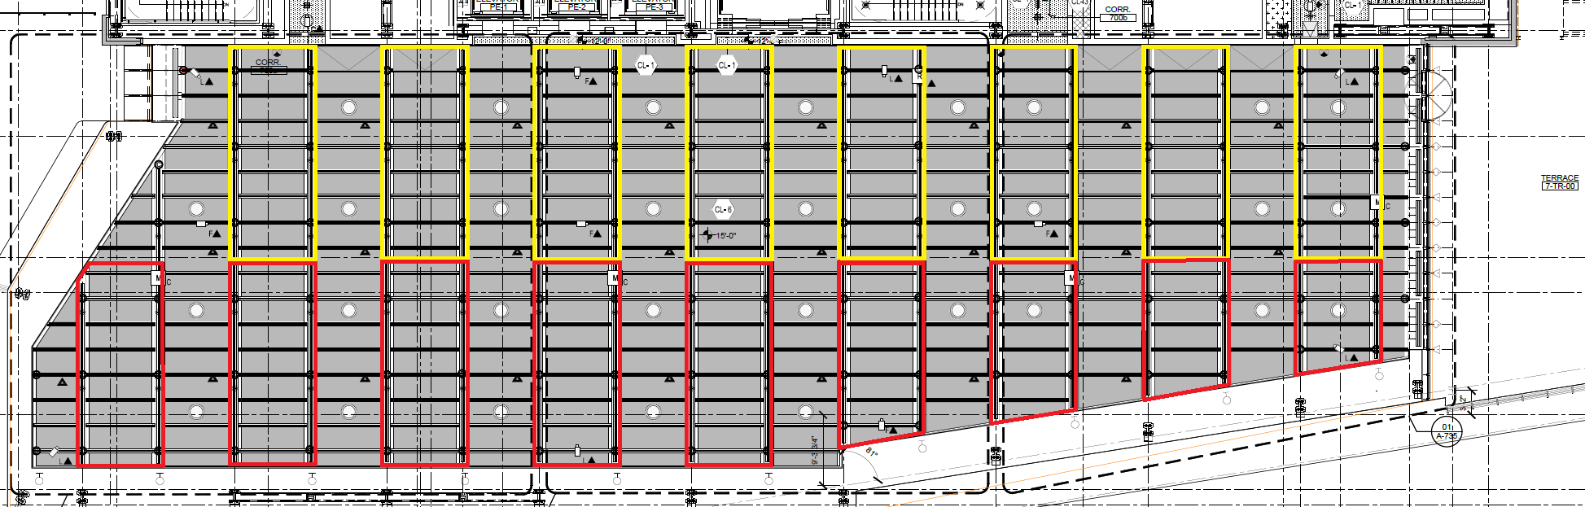
INTRODUCTION | PROJECT OVERVIEW | ANALYSIS 1: GALLERY CEILING PREFABRICATION | ANALYSIS 1A: GALLERY CEILING REDESIGN | ANALYSIS 3: GALLERY FIT-OUT SIPS | CONCLUSIONS AND RECOMMENDATIONS
7th FLOOR GALLERY MODULE LAYOUT
Gallery Dimensions
  180’6” x 55’4”
Module Inventory: 17 Total
  (8), 28’4” Modules
  (5), 28’ Modules
  (4), Varying Length

Slide 25
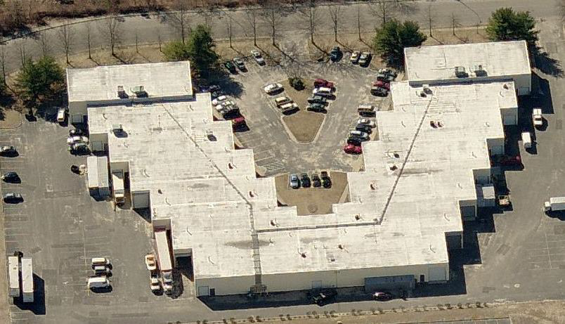
INTRODUCTION | PROJECT OVERVIEW | ANALYSIS 1: GALLERY CEILING PREFABRICATION | ANALYSIS 1A: GALLERY CEILING REDESIGN | ANALYSIS 3: GALLERY FIT-OUT SIPS | CONCLUSIONS AND RECOMMENDATIONS
MANUFACTURING WAREHOUSE
Benefits
  Reduces on-site construction time.
  Safer and more productive workforce.
Considerations
  Size
    Need 11,000 SF to construct and store units.
  Location
  Cost

Slide 26
INTRODUCTION | PROJECT OVERVIEW | ANALYSIS 1: GALLERY CEILING PREFABRICATION | ANALYSIS 1A: GALLERY CEILING REDESIGN | ANALYSIS 3: GALLERY FIT-OUT SIPS | CONCLUSIONS AND RECOMMENDATIONS
MANUFACTURING WAREHOUSE
Selected Warehouse Specifications:
  12,420 SF
    Allows for a 3 station assembly line & storage
  Approximately 50 miles from the site.
  Costs $7.25 SF/Yr
    5 month lease needed
    $37,500

Slide 27
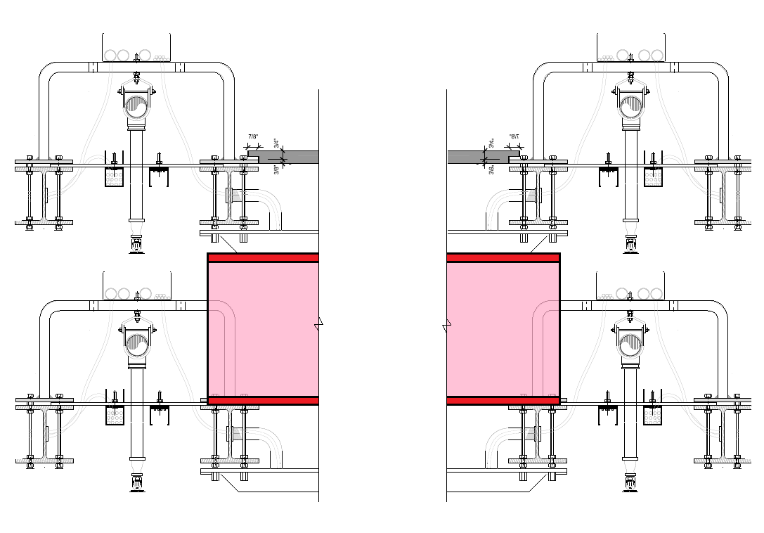
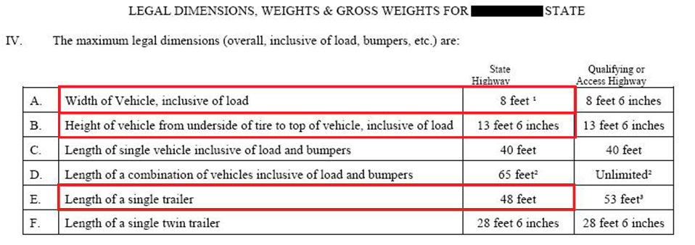
INTRODUCTION | PROJECT OVERVIEW | ANALYSIS 1: GALLERY CEILING PREFABRICATION | ANALYSIS 1A: GALLERY CEILING REDESIGN | ANALYSIS 3: GALLERY FIT-OUT SIPS | CONCLUSIONS AND RECOMMENDATIONS
TRANSPORTATION
Limit the amount of loads to the site.
  Stacking the modules: Max Height 13’6”
    1’ High wooden pallets
    Total module height: 1’5-1/2”
      Modules stacked 6 high

Slide 28
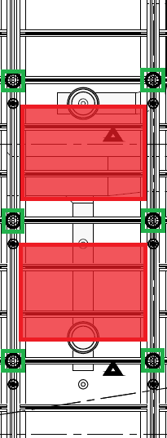
INTRODUCTION | PROJECT OVERVIEW | ANALYSIS 1: GALLERY CEILING PREFABRICATION | ANALYSIS 1A: GALLERY CEILING REDESIGN | ANALYSIS 3: GALLERY FIT-OUT SIPS | CONCLUSIONS AND RECOMMENDATIONS
TRANSPORTATION
Limit the amount of loads to the site.
  Stacking the modules: Max Height 13’6”
    1’ High wooden pallets
    Total module height: 1’5-1/2”
      Modules stacked 6 high

Slide 29
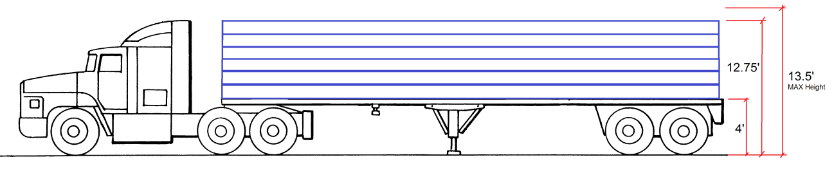
INTRODUCTION | PROJECT OVERVIEW | ANALYSIS 1: GALLERY CEILING PREFABRICATION | ANALYSIS 1A: GALLERY CEILING REDESIGN | ANALYSIS 3: GALLERY FIT-OUT SIPS | CONCLUSIONS AND RECOMMENDATIONS
TRANSPORTATION
Limit the amount of loads to the site.
  Stacking the modules: Max Height 13’6”
    1’ High wooden pallets
    Total module height: 1’5-1/2”
      Modules stacked 6 high

Slide 30
INTRODUCTION | PROJECT OVERVIEW | ANALYSIS 1: GALLERY CEILING PREFABRICATION | ANALYSIS 1A: GALLERY CEILING REDESIGN | ANALYSIS 3: GALLERY FIT-OUT SIPS | CONCLUSIONS AND RECOMMENDATIONS
TRANSPORTATION
9 Truckloads needed
Transportation Costs
  $400 / Shipment
  $40 / Permit
  Wooden Pallets - $10,600
  Loading Labor & Equipment – $6,600
  Total: $21,250

Slide 31
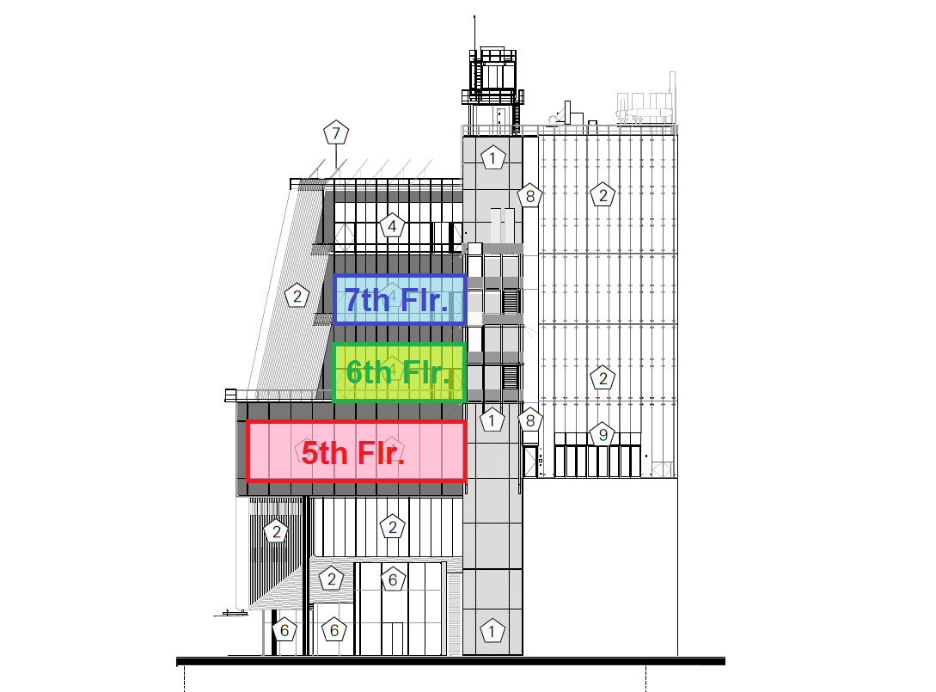
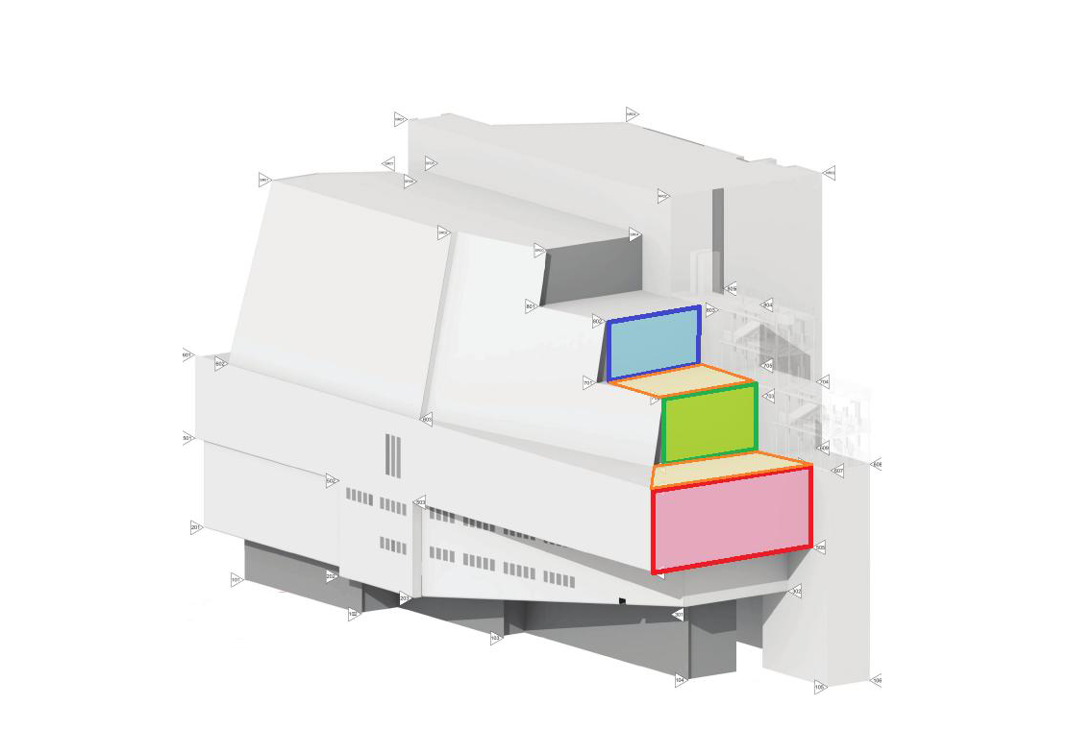
INTRODUCTION | PROJECT OVERVIEW | ANALYSIS 1: GALLERY CEILING PREFABRICATION | ANALYSIS 1A: GALLERY CEILING REDESIGN | ANALYSIS 3: GALLERY FIT-OUT SIPS | CONCLUSIONS AND RECOMMENDATIONS
HOISTING
Hoist into place before east side curtain wall work.
  E. Curtain Wall Start: 10/25/13.
3 days needed to hoist 77 modules.
  Truck mounted hydraulic crane.
Module storage in center of the galleries until needed.

Slide 32
INTRODUCTION | PROJECT OVERVIEW | ANALYSIS 1: GALLERY CEILING PREFABRICATION | ANALYSIS 1A: GALLERY CEILING REDESIGN | ANALYSIS 3: GALLERY FIT-OUT SIPS | CONCLUSIONS AND RECOMMENDATIONS
INSTALLATION
Sequence of New Activities
  Module Positioning & Hoisting:
    Average of 2 Days / Gallery
  Remaining W5 Installation:
    2 Days / Gallery
  Remaining Lighting Assembly Installation:
    Average of 2 Days / Gallery
  Electrical &Fire Protection Connections:
    Average of 2 Days Each / Gallery

Slide 33
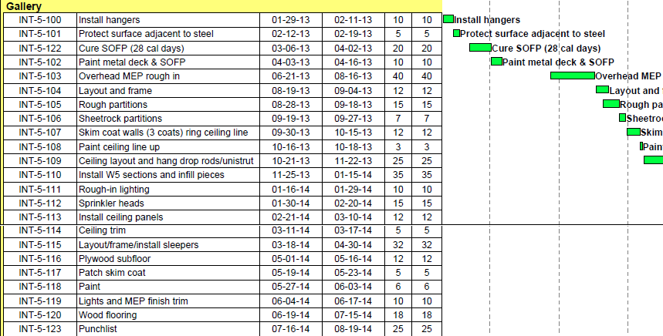
INTRODUCTION | PROJECT OVERVIEW | ANALYSIS 1: GALLERY CEILING PREFABRICATION | ANALYSIS 1A: GALLERY CEILING REDESIGN | ANALYSIS 3: GALLERY FIT-OUT SIPS | CONCLUSIONS AND RECOMMENDATIONS
SCHEDULE ANALYSIS
Schedule remains the same until the MEP Rough-In activity.
Eighth floor gallery fit-out will be started first.
  Followed by 5th – 7th in order.
On site construction reduced from 85 days to 14 per prefabricated gallery.
New gallery fit-out schedule shortened by 41 working days.
Overall project schedule shortened by 26 working days.
ESTIMATED SCHEDULE REDUCTION PER GALLERY
Activity | Original Duration | Percentage Reduced | New Duration | Work Days Saved or Lost
Ceiling Layout/ Drop Rods | 25 | 100 | 0 | 25
Install W5 Sections | 35 | 95 | 2 | 33
Rough-In Lighting | 10 | 100 | 0 | 10
Sprinkler System | 15 | 100 | 0 | 15
Module Positioning & Hoisting | 0 | n/a | 2 | 2
Lighting Assembly Installation | 0 | n/a | 2 | 2
Electrical Connections | 0 | n/a | 6 | 6
Fire Protection Connections | 0 | n/a | 2 | 2
Total | 85 |  | 14 | 71

Slide 34
INTRODUCTION | PROJECT OVERVIEW | ANALYSIS 1: GALLERY CEILING PREFABRICATION | ANALYSIS 1A: GALLERY CEILING REDESIGN | ANALYSIS 3: GALLERY FIT-OUT SIPS | CONCLUSIONS AND RECOMMENDATIONS
COST ANALYSIS
COST IMPLICATIONS OF THE PREFABRICATION PROCESS
Item | Description | Cost Impact ($)
Manufacturing
Warehouse Rental | Five months rent of 12,420 SF @ $7.25/SF/Yr. | 37,518.75
Additional Labor | Laborer to move modules between stations. | 48,432.38
Transportation
Trucking Costs | Nine Trucks at $400/Truck. | 3,600.00
Permits | Nine Permits at $40/Permit. | 360.00
Wood Pallets | 57 Custom Pallets | 10,613.65
Loading Costs | Crane, Labor, & Operating Costs at the Warehouse | 6,680.56
Installation
Hydraulic Crane | Three days rent, mobilization costs, and labor associated with receiving the modules. | 10,739.56
Installation Labor | Labor associated with the new activities. | 33,987.76
General Conditions | Five weeks of general conditions savings. | 497,500.00
Net Total |  | 345,567.34
General Conditions savings of $99,500 per week.
  $497,500 saved over 5 weeks.
Prefabrication Expenses totaled $151,933
Total Savings of $345,567

Slide 35
INTRODUCTION | PROJECT OVERVIEW | ANALYSIS 1: GALLERY CEILING PREFABRICATION | ANALYSIS 1A: GALLERY CEILING REDESIGN | ANALYSIS 3: GALLERY FIT-OUT SIPS | CONCLUSIONS AND RECOMMENDATIONS
CONCLUSION & RECOMMENDATION
Schedule Savings: 5 Weeks
Cost Savings: $345,000
Implement the prefabrication process.

Slide 36
INTRODUCTION | PROJECT OVERVIEW | ANALYSIS 1: GALLERY CEILING PREFABRICATION | ANALYSIS 1A: GALLERY CEILING REDESIGN | ANALYSIS 3: GALLERY FIT-OUT SIPS | CONCLUSIONS AND RECOMMENDATIONS
ANALYSIS 1A:
GALLERY CEILING REDESIGN
Architectural Breadth

Slide 37
INTRODUCTION | PROJECT OVERVIEW | ANALYSIS 1: GALLERY CEILING PREFABRICATION | ANALYSIS 1A: GALLERY CEILING REDESIGN | ANALYSIS 3: GALLERY FIT-OUT SIPS | CONCLUSIONS AND RECOMMENDATIONS
PROBLEM IDENTIFICATION AND GOALS
Problem:
  Ceiling system takes over 100 days to construct.
  Labor and cost intensive.
Goal:
  Modify the architectural design in order to facilitate a faster construction sequence.

Slide 38
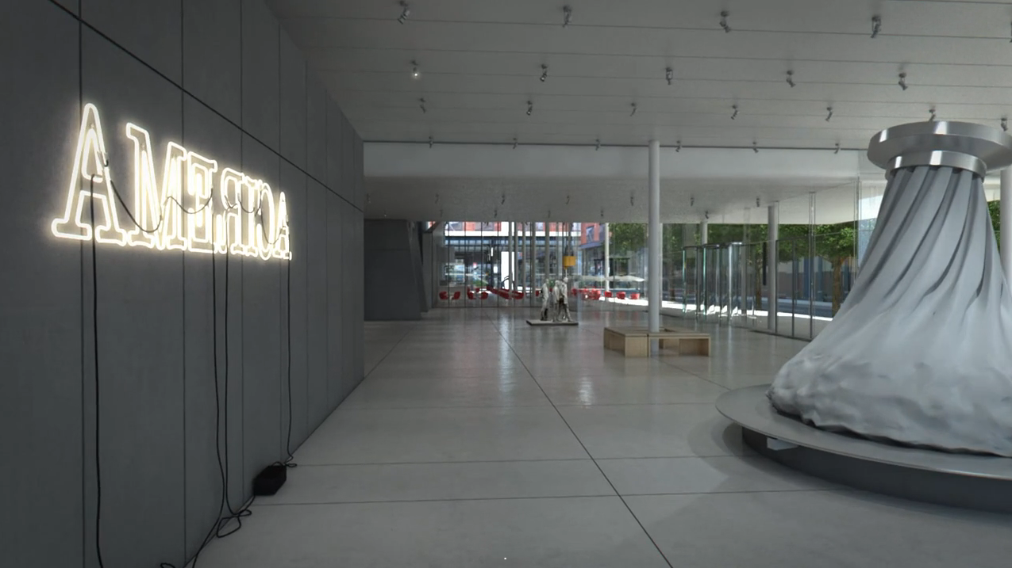
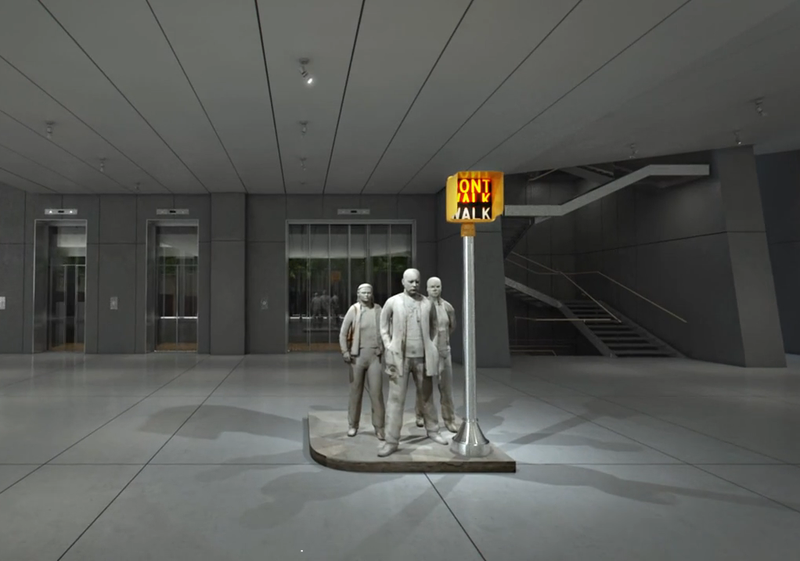
INTRODUCTION | PROJECT OVERVIEW | ANALYSIS 1: GALLERY CEILING PREFABRICATION | ANALYSIS 1A: GALLERY CEILING REDESIGN | ANALYSIS 3: GALLERY FIT-OUT SIPS | CONCLUSIONS AND RECOMMENDATIONS
ORIGINAL CEILING DESIGN & ARCHITECTURE
MMAA Interior Architecture
  Minimalistic Interior Spaces
    Accentuates the Art Showcases
  Few Gallery Finishes
    Wood Plank Floor
    Drywall Walls
    Steel Grid Ceiling is the only ornate finish.

Slide 39
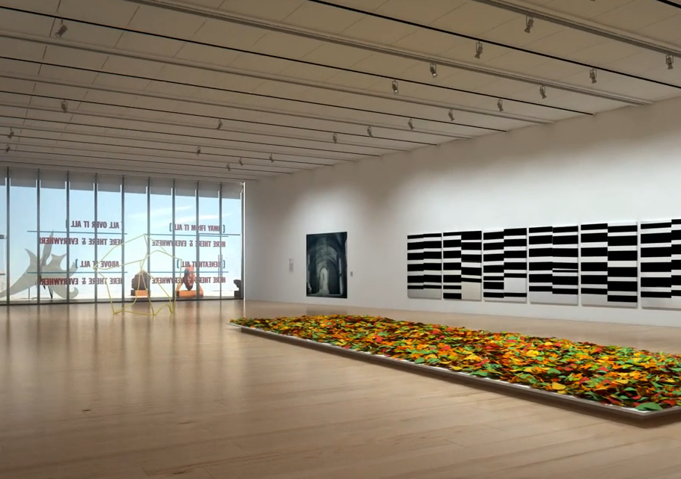
INTRODUCTION | PROJECT OVERVIEW | ANALYSIS 1: GALLERY CEILING PREFABRICATION | ANALYSIS 1A: GALLERY CEILING REDESIGN | ANALYSIS 3: GALLERY FIT-OUT SIPS | CONCLUSIONS AND RECOMMENDATIONS
ORIGINAL CEILING DESIGN & ARCHITECTURE
MMAA Interior Architecture
  Minimalistic Interior Spaces
    Accentuates the Art Showcases
  Few Gallery Finishes
    Wood Plank Floor
    Gypsum Board Walls
    Steel Grid Ceiling is the only ornate finish.

Slide 40
INTRODUCTION | PROJECT OVERVIEW | ANALYSIS 1: GALLERY CEILING PREFABRICATION | ANALYSIS 1A: GALLERY CEILING REDESIGN | ANALYSIS 3: GALLERY FIT-OUT SIPS | CONCLUSIONS AND RECOMMENDATIONS
ORIGINAL CEILING DESIGN & ARCHITECTURE
MMAA Exterior Architecture
  Unique Building Shape
    Stepped Terraces
    Top Cone Structure
    Cantilevered Entrance

Slide 41
INTRODUCTION | PROJECT OVERVIEW | ANALYSIS 1: GALLERY CEILING PREFABRICATION | ANALYSIS 1A: GALLERY CEILING REDESIGN | ANALYSIS 3: GALLERY FIT-OUT SIPS | CONCLUSIONS AND RECOMMENDATIONS
ORIGINAL CEILING DESIGN & ARCHITECTURE
MMAA Exterior Architecture
  Unique Building Shape
    Stepped Terraces
    Top Cone Structure
    Cantilevered Entrance

Slide 42
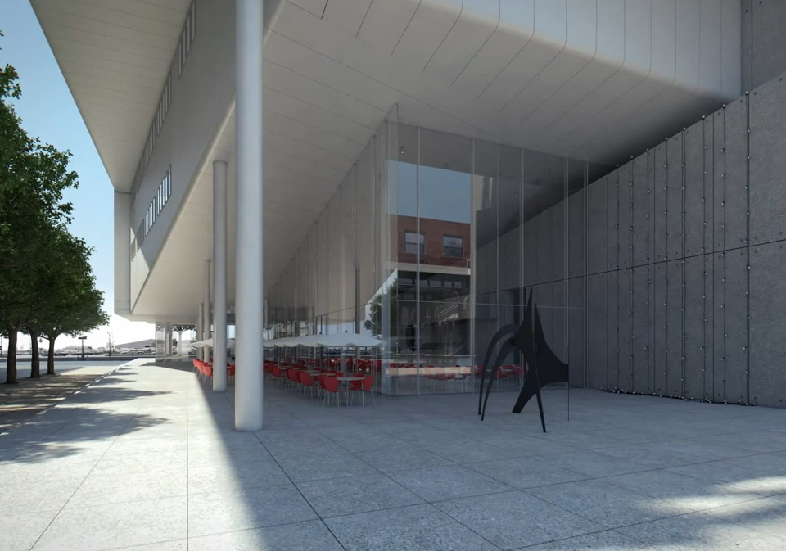
INTRODUCTION | PROJECT OVERVIEW | ANALYSIS 1: GALLERY CEILING PREFABRICATION | ANALYSIS 1A: GALLERY CEILING REDESIGN | ANALYSIS 3: GALLERY FIT-OUT SIPS | CONCLUSIONS AND RECOMMENDATIONS
ORIGINAL CEILING DESIGN & ARCHITECTURE
MMAA Exterior Architecture
  Unique Building Shape
    Stepped Terraces
    Top Cone Structure
    Cantilevered Entrance

Slide 43
INTRODUCTION | PROJECT OVERVIEW | ANALYSIS 1: GALLERY CEILING PREFABRICATION | ANALYSIS 1A: GALLERY CEILING REDESIGN | ANALYSIS 3: GALLERY FIT-OUT SIPS | CONCLUSIONS AND RECOMMENDATIONS
DESIGN GOALS
Maintain the uniqueness.
Expose the MEP & structural systems, but don’t focus on them.
Simpler construction methods.
Cost effective solution.
Keep the ceiling height the same.
Do not disturb the mechanical systems.

Slide 44
INTRODUCTION | PROJECT OVERVIEW | ANALYSIS 1: GALLERY CEILING PREFABRICATION | ANALYSIS 1A: GALLERY CEILING REDESIGN | ANALYSIS 3: GALLERY FIT-OUT SIPS | CONCLUSIONS AND RECOMMENDATIONS
ORIGINAL CEILING SCHEDULE & COSTS
ORIGINAL 5th FLOOR GALLERY CEILING SYSTEM TAKEOFFS
Item | Unit | Quantity
W5x16 Members | LF | 3,564
2x2x1/4 Angle Members | LF | 8,974
C5x09 Members | LF | 451
Bent Steel Plate Hanger | EA | 189
Ceiling Structure takes 77 working days to complete.
5th Floor Ceiling System costs $461K
  Total: $1.16M
ORIGINAL GALLERY CEILING ACTIVITY LENGTHS
Activity | Duration (Working Days)
Ceiling Layout/ Hanging Drop Rods | 25
Install W5 Sections & Infill Pieces | 35
Install Ceiling Panels | 12
Ceiling Trim | 5
Total | 77
GALLERY CEILING ESTIMATES
Item | Unit | Quantity
5th Floor Gallery Cost | $ | 461,353
Cost Per Square Foot | $/SF | 26.89
5th-8th Floor Cost Extrapolated | $ | 1,157,146

Slide 45
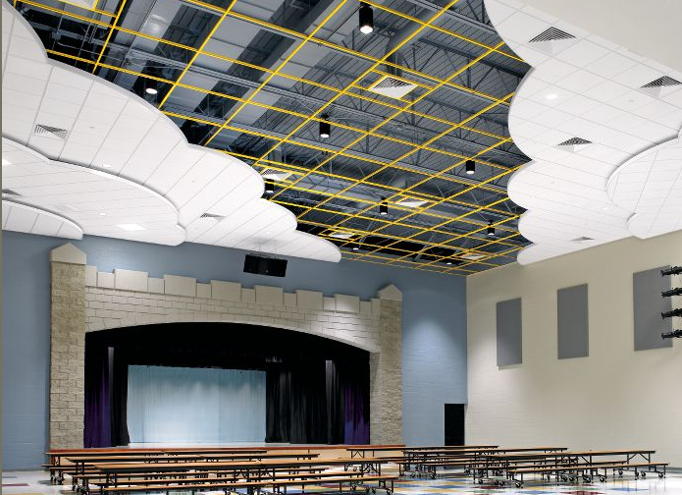
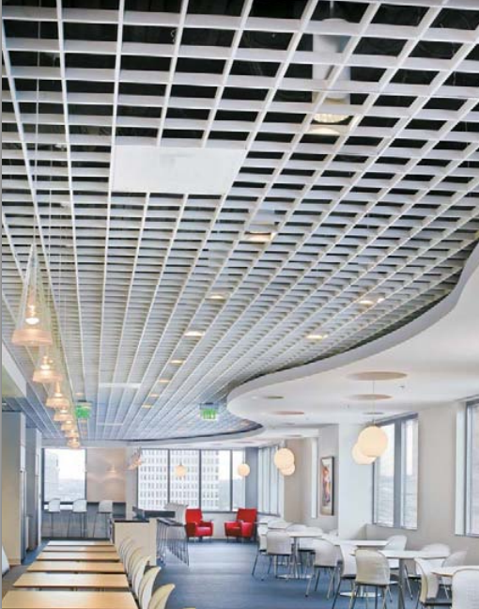
INTRODUCTION | PROJECT OVERVIEW | ANALYSIS 1: GALLERY CEILING PREFABRICATION | ANALYSIS 1A: GALLERY CEILING REDESIGN | ANALYSIS 3: GALLERY FIT-OUT SIPS | CONCLUSIONS AND RECOMMENDATIONS
NEW CEILING DESIGN (Arch. Breadth)
Two Part Ceiling System
  Perimeter: Tegular Acoustical Panels
  Center: 8” Square Open Cell Grid
    Exposes 90% of the ceiling above.
Structure above painted dark blue.

Slide 46
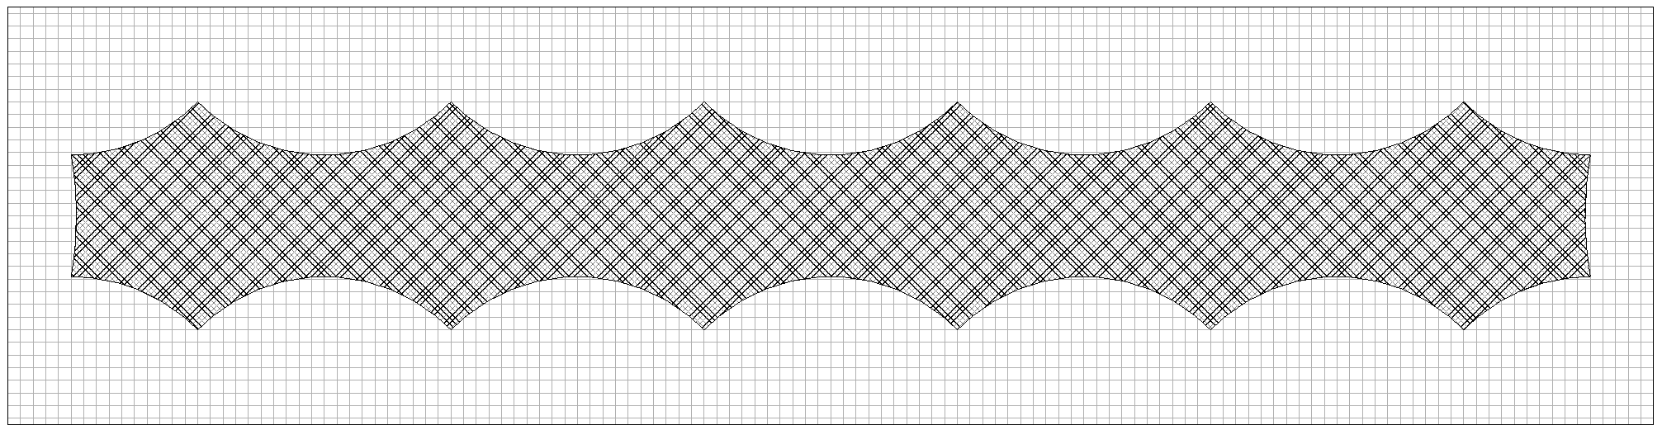
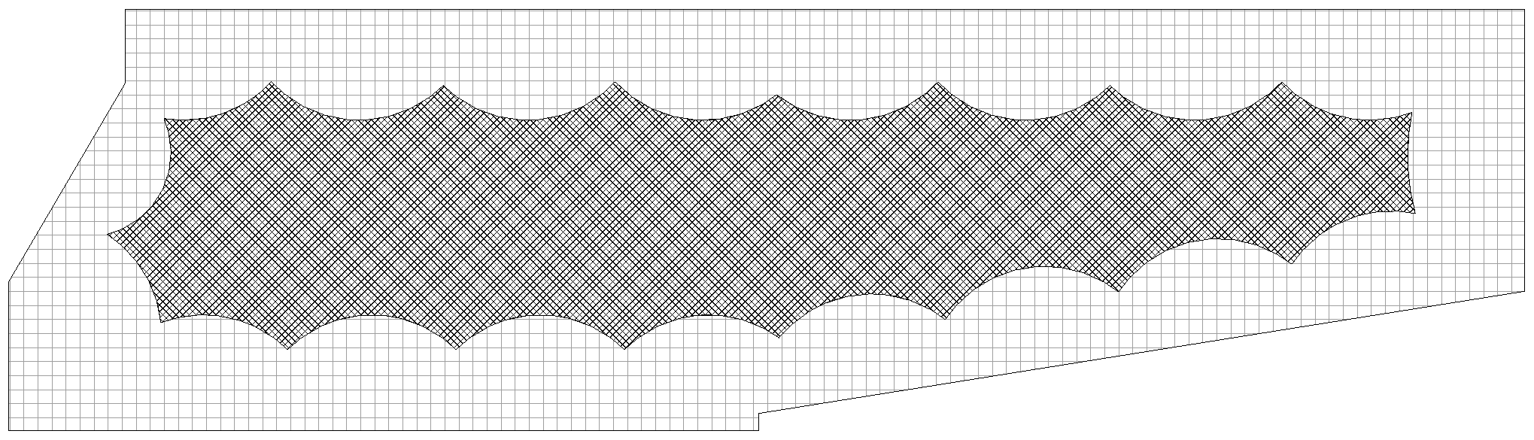
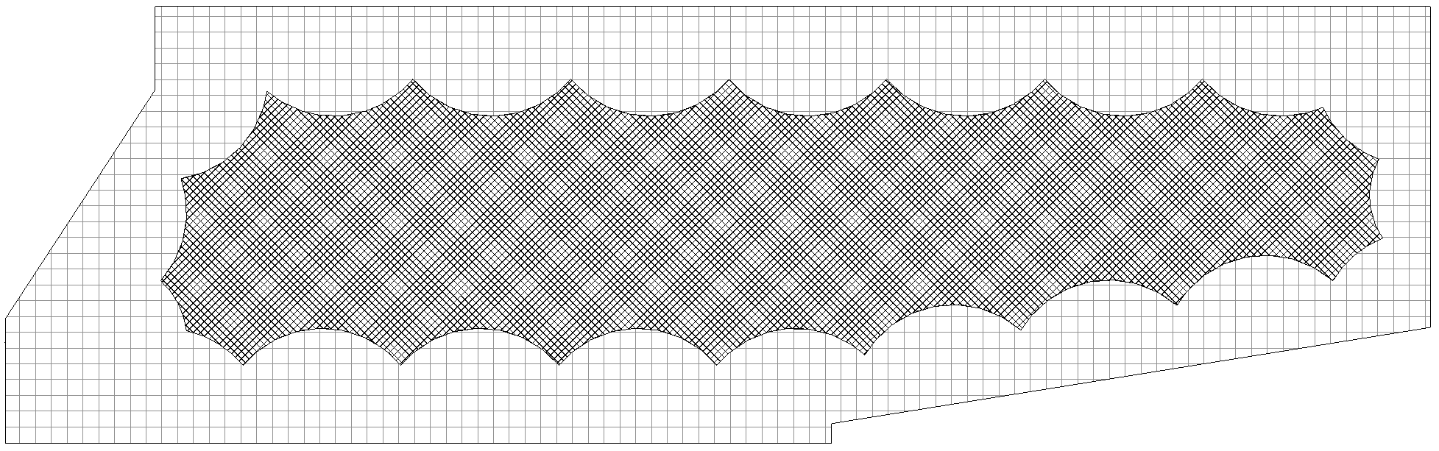
INTRODUCTION | PROJECT OVERVIEW | ANALYSIS 1: GALLERY CEILING PREFABRICATION | ANALYSIS 1A: GALLERY CEILING REDESIGN | ANALYSIS 3: GALLERY FIT-OUT SIPS | CONCLUSIONS AND RECOMMENDATIONS
NEW CEILING DESIGN (Arch. Breadth)
5th Floor Gallery
7th Floor Gallery
6th Floor Gallery

Slide 47
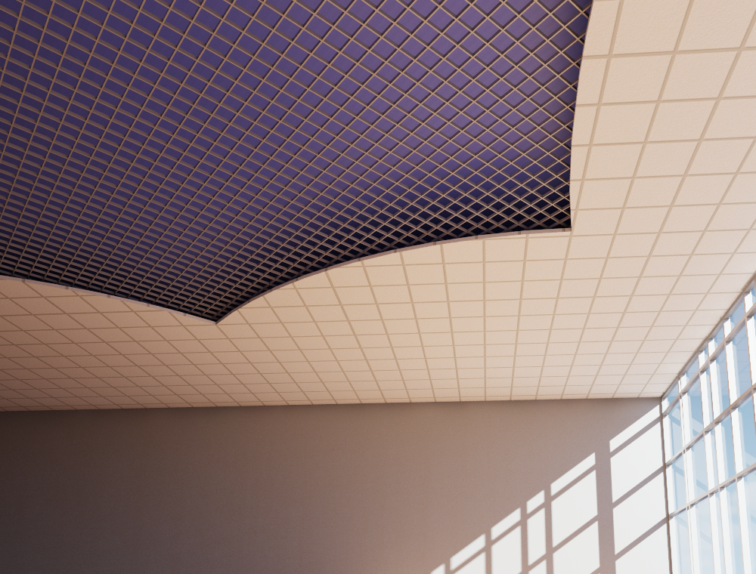
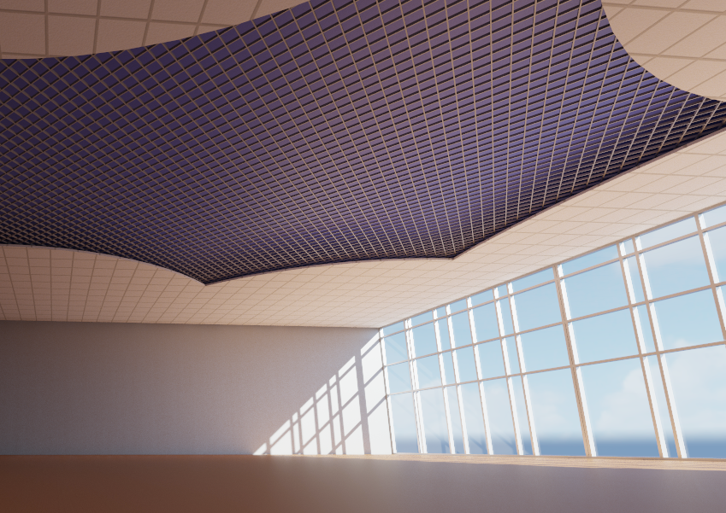
INTRODUCTION | PROJECT OVERVIEW | ANALYSIS 1: GALLERY CEILING PREFABRICATION | ANALYSIS 1A: GALLERY CEILING REDESIGN | ANALYSIS 3: GALLERY FIT-OUT SIPS | CONCLUSIONS AND RECOMMENDATIONS
NEW CEILING DESIGN (Arch. Breadth)
CEILING SYSTEM TAKEOFFS BY FLOOR
Floor | Total (SF) | Acoustical Ceiling (SF) | Open Cell Grid (SF)
5th | 17,160 | 11,317 | 5,843
6th | 11,353 | 6,574 | 4,779
7th | 9,467 | 4,884 | 4,583
8TH | 5,060 | 0 | 5,060
Total | 43,040 | 22,775 | 20,265

Slide 48
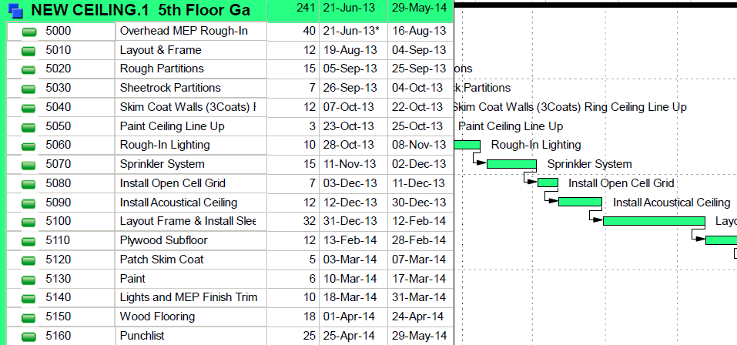
INTRODUCTION | PROJECT OVERVIEW | ANALYSIS 1: GALLERY CEILING PREFABRICATION | ANALYSIS 1A: GALLERY CEILING REDESIGN | ANALYSIS 3: GALLERY FIT-OUT SIPS | CONCLUSIONS AND RECOMMENDATIONS
NEW CEILING SCHEDULE
CEILING SYSTEM TAKEOFFS BY FLOOR
Floor | Acoustical Ceiling (SF) | Open Cell Grid (SF) | Installation Time for AC (Days) | Installation Time for Grid (Days)
5th | 11,317 | 5,843 | 12 | 7
6th | 6,574 | 4,779 | 7 | 6
7th | 4,884 | 4,583 | 5 | 6
8TH | 0 | 5,060 | 0 | 6
Total |  |  | 24 | 25
Average Length of Construction:
  Original Ceiling: 77 Days
  Redesigned Ceiling: 12 Days
Shortened Gallery Fit-Out Schedule by 83 working Days.
Shortened the Overall Project Schedule by 26 Working Days.
NOTE: Productivity Values:
  Acoustical Panels (4 Carp): 1000 SF/Day
  Open Cell Grid (2 Carp): 860 SF/Day

Slide 49
INTRODUCTION | PROJECT OVERVIEW | ANALYSIS 1: GALLERY CEILING PREFABRICATION | ANALYSIS 1A: GALLERY CEILING REDESIGN | ANALYSIS 3: GALLERY FIT-OUT SIPS | CONCLUSIONS AND RECOMMENDATIONS
NEW CEILING COST
ORIGINAL VS REDESIGNED CEILING SYSTEM ESTIMATES
Floor | Original Estimate ($) | Redesigned Estimate ($) | Difference ($)
5th | 461,353 | 196,129 | 265,224
Total | 1,157,147 | 473,701 | 683,446
5th Floor Gallery Ceiling Estimate:
  $196,000
Total Ceiling System Estimate
  $474,000
Redesign Cost Savings:
  $683,000
Total Cost Savings:
  $1,181,000
REDESIGNED CEILING SYSTEM COST SAVINGS
Description | Cost Savings ($)
Material & Labor Savings | 683,446
General Conditions Savings | 497,500
Total | 1,180,946

Slide 50
INTRODUCTION | PROJECT OVERVIEW | ANALYSIS 1: GALLERY CEILING PREFABRICATION | ANALYSIS 1A: GALLERY CEILING REDESIGN | ANALYSIS 3: GALLERY FIT-OUT SIPS | CONCLUSIONS AND RECOMMENDATIONS
CONCLUSION & RECOMMENDATION
Schedule Savings: 5 Weeks
Cost Savings: $1.18M
Implement the redesigned ceiling system.
Final Decision is up to the Owner.

Slide 51
INTRODUCTION | PROJECT OVERVIEW | ANALYSIS 1: GALLERY CEILING PREFABRICATION | ANALYSIS 1A: GALLERY CEILING REDESIGN | ANALYSIS 3: GALLERY FIT-OUT SIPS | CONCLUSIONS AND RECOMMENDATIONS
ANALYSIS 2:
SHORT INTERVAL PRODUCTION SCHEDULE

Slide 52
INTRODUCTION | PROJECT OVERVIEW | ANALYSIS 1: GALLERY CEILING PREFABRICATION | ANALYSIS 1A: GALLERY CEILING REDESIGN | ANALYSIS 3: GALLERY FIT-OUT SIPS | CONCLUSIONS AND RECOMMENDATIONS
PROBLEM IDENTIFICATION AND GOALS
Problem:
  Gallery Fit-Outs take over 400 days on average to complete.
Goal:
  Reduce the Gallery Fit-Out length in order to reduce the overall project schedule.

Slide 53
INTRODUCTION | PROJECT OVERVIEW | ANALYSIS 1: GALLERY CEILING PREFABRICATION | ANALYSIS 1A: GALLERY CEILING REDESIGN | ANALYSIS 3: GALLERY FIT-OUT SIPS | CONCLUSIONS AND RECOMMENDATIONS
PROBLEM ANALYSIS
Reasons for long gallery fit-outs.
  Start to Finish activity relationships.
  Only one trade in each gallery performing work at a time.
A SIPS will expedite this schedule area.

Slide 54
INTRODUCTION | PROJECT OVERVIEW | ANALYSIS 1: GALLERY CEILING PREFABRICATION | ANALYSIS 1A: GALLERY CEILING REDESIGN | ANALYSIS 3: GALLERY FIT-OUT SIPS | CONCLUSIONS AND RECOMMENDATIONS
ACTIVITY ANALYSIS
SIPS will focus on 5th – 8th floor galleries
Will commence with the “MEP Rough In”
Activities adjusted to a 20 day maximum schedule length per gallery.
  Ex: MEP Rough In
Crew Sizes adjusted to make each activity length 20 days / gallery.

Slide 55
INTRODUCTION | PROJECT OVERVIEW | ANALYSIS 1: GALLERY CEILING PREFABRICATION | ANALYSIS 1A: GALLERY CEILING REDESIGN | ANALYSIS 3: GALLERY FIT-OUT SIPS | CONCLUSIONS AND RECOMMENDATIONS
ZONE DEFINITION
A SIPS is most effective when the zone sizes are equal.
MMAA zones will be approximately 5,000 SF.
Gives a total of 8 zones.
Total schedule length (80 days / activity) will be split evenly between the 8 zones.
  Creates 10 day activity lengths / zone.
SQUARE FOOTAGE PER GALLERY
Floor | Square Footage | Number of Zones | Square Footage Per Zone
5th | 17,160 | 3 | 5,700
6th | 11,353 | 2 | 5,675
7th | 9,467 | 2 | 4,734
8th | 5,060 | 1 | 5,060
Total | 43,040 | 8 | 5,380

Slide 56
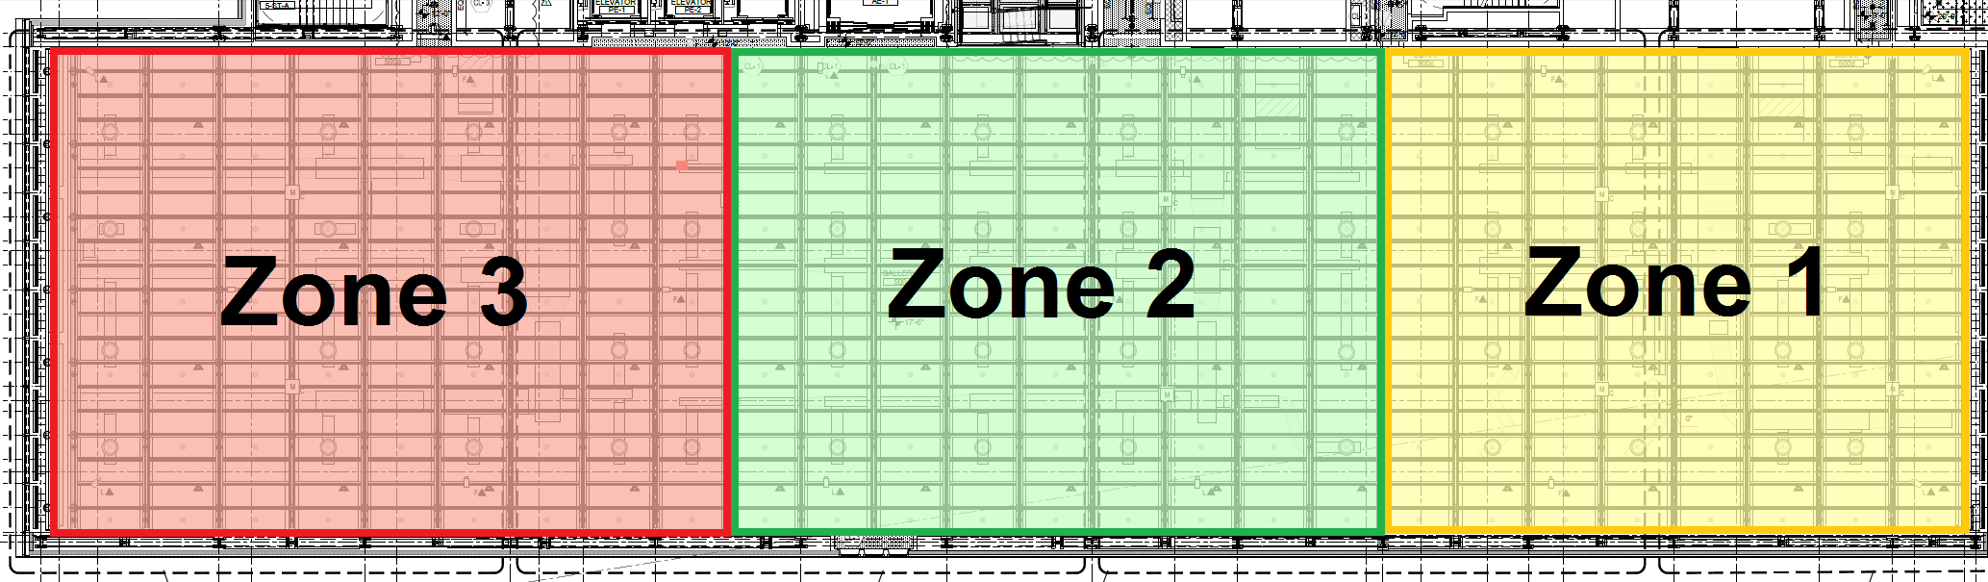
INTRODUCTION | PROJECT OVERVIEW | ANALYSIS 1: GALLERY CEILING PREFABRICATION | ANALYSIS 1A: GALLERY CEILING REDESIGN | ANALYSIS 3: GALLERY FIT-OUT SIPS | CONCLUSIONS AND RECOMMENDATIONS
5th FLOOR ZONES
3 Zones:
  Average of 5,700 SF

Slide 57
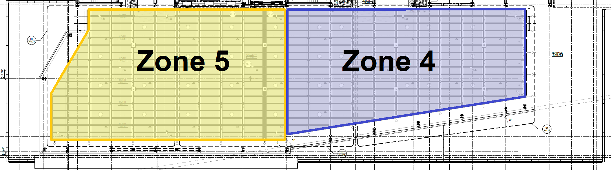
INTRODUCTION | PROJECT OVERVIEW | ANALYSIS 1: GALLERY CEILING PREFABRICATION | ANALYSIS 1A: GALLERY CEILING REDESIGN | ANALYSIS 3: GALLERY FIT-OUT SIPS | CONCLUSIONS AND RECOMMENDATIONS
6th FLOOR ZONES
2 Zones:
  Average of 5,675 SF

Slide 58
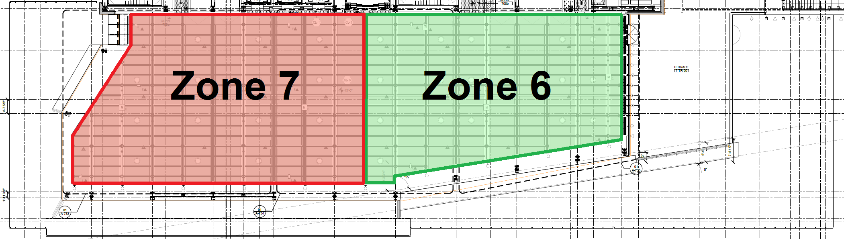
INTRODUCTION | PROJECT OVERVIEW | ANALYSIS 1: GALLERY CEILING PREFABRICATION | ANALYSIS 1A: GALLERY CEILING REDESIGN | ANALYSIS 3: GALLERY FIT-OUT SIPS | CONCLUSIONS AND RECOMMENDATIONS
7th FLOOR ZONES
2 Zones:
  Average of 4,734 SF

Slide 59
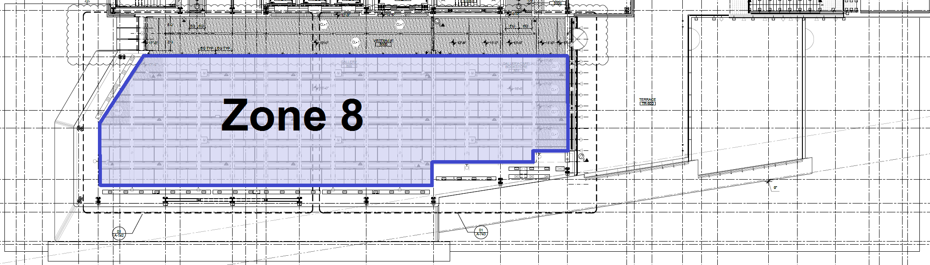
INTRODUCTION | PROJECT OVERVIEW | ANALYSIS 1: GALLERY CEILING PREFABRICATION | ANALYSIS 1A: GALLERY CEILING REDESIGN | ANALYSIS 3: GALLERY FIT-OUT SIPS | CONCLUSIONS AND RECOMMENDATIONS
8th FLOOR ZONE
1 Zone:
  Average of 5,060 SF

Slide 60
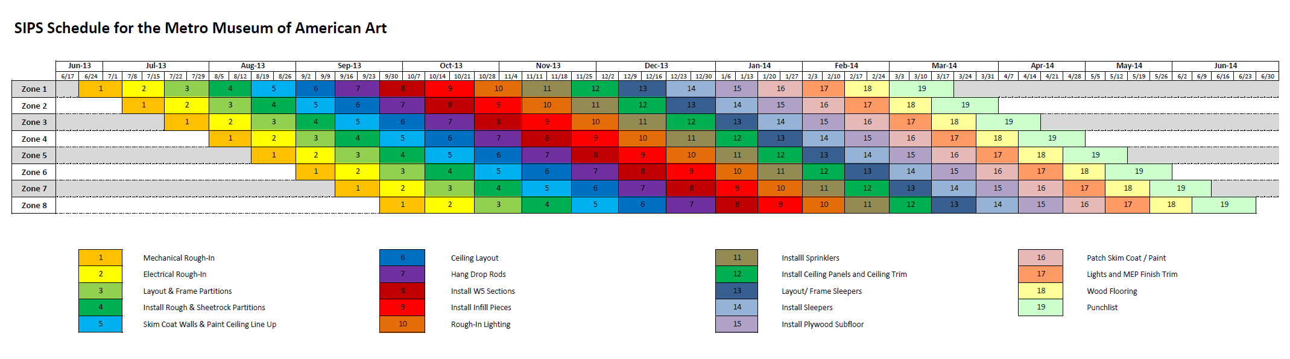
INTRODUCTION | PROJECT OVERVIEW | ANALYSIS 1: GALLERY CEILING PREFABRICATION | ANALYSIS 1A: GALLERY CEILING REDESIGN | ANALYSIS 3: GALLERY FIT-OUT SIPS | CONCLUSIONS AND RECOMMENDATIONS

Slide 61
INTRODUCTION | PROJECT OVERVIEW | ANALYSIS 1: GALLERY CEILING PREFABRICATION | ANALYSIS 1A: GALLERY CEILING REDESIGN | ANALYSIS 3: GALLERY FIT-OUT SIPS | CONCLUSIONS AND RECOMMENDATIONS
SCHEDULE ANALYSIS
SIPS shortened the gallery fit-out from 17 to 12 months.
  Doubled the amount of work being completed at a time.
  Consistent & efficient flow of trades.
No extra man-hours were worked due to the SIPS.
Overall project schedule reduced by 26 working days.
SIPS SUMMARY
Gallery | Start Date | Finish Date | SIPS Schedule Length (Weeks)
5th | 6/24/13 | 4/18/14 | 43
6th | 8/5/13 | 5/16/14 | 41
7th | 9/2/13 | 6/13/14 | 41
8th | 9/30/13 | 6/27/14 | 39
Overall | 6/24/13 | 6/27/14 | 53

Slide 62
INTRODUCTION | PROJECT OVERVIEW | ANALYSIS 1: GALLERY CEILING PREFABRICATION | ANALYSIS 1A: GALLERY CEILING REDESIGN | ANALYSIS 3: GALLERY FIT-OUT SIPS | CONCLUSIONS AND RECOMMENDATIONS
COST ANALYSIS
Total man-hours and material usage remained the same.
  No additional costs were incurred.
5 week of general conditions were saved.
  Results in $497,500 in savings.
SIPS SUMMARY
Gallery | Start Date | Finish Date | SIPS Schedule Length (Weeks)
5th | 6/24/13 | 4/18/14 | 43
6th | 8/5/13 | 5/16/14 | 41
7th | 9/2/13 | 6/13/14 | 41
8th | 9/30/13 | 6/27/14 | 39
Overall | 6/24/13 | 6/27/14 | 53

Slide 63
INTRODUCTION | PROJECT OVERVIEW | ANALYSIS 1: GALLERY CEILING PREFABRICATION | ANALYSIS 1A: GALLERY CEILING REDESIGN | ANALYSIS 3: GALLERY FIT-OUT SIPS | CONCLUSIONS AND RECOMMENDATIONS
CONCLUSION & RECOMMENDATION
Schedule Savings: 5 Weeks
Cost Savings: $497,500
Implement the SIPS.

Slide 64
INTRODUCTION | PROJECT OVERVIEW | ANALYSIS 1: GALLERY CEILING PREFABRICATION | ANALYSIS 1A: GALLERY CEILING REDESIGN | ANALYSIS 3: GALLERY FIT-OUT SIPS | CONCLUSIONS AND RECOMMENDATIONS
CONCLUSION & RECOMMENDATION
Prefabrication Analysis
  Schedule Savings: 5 Weeks
  Cost Savings: $345,000
Redesign Analysis
  Schedule Savings: 5 Weeks
  Cost Savings: $1,181,000
SIPS Analysis
  Schedule Savings: 5 Weeks
  Cost Savings: $497,500
Recommendations:
  Implement the SIPS.
  Implement the redesign at the owners discretion.

Slide 65
INTRODUCTION | PROJECT OVERVIEW | ANALYSIS 1: GALLERY CEILING PREFABRICATION | ANALYSIS 1A: GALLERY CEILING REDESIGN | ANALYSIS 3: GALLERY FIT-OUT SIPS | CONCLUSIONS AND RECOMMENDATIONS
ACKNOWLEDGEMENTS
QUESTIONS?
Metro Museum of American Art
Renzo Piano Building Workshop
Ray Sowers: CM Advisor
Penn State AE Faculty
Family & Friends

